Slide 1
Automated Predictive Modeling and Knowledge Discovery for Biomedicine
Ioannis Tsamardinos
professor, CSD, University of Crete
Gnosis Data Analysis, co-founder

Slide 2
Conflict of Interest Declaration
Some of the research and algorithmic results are commercially exploited by Gnosis Data Analysis PC

Slide 3
The Past Predicts the Future
"I have seen the future and it is very much like the present, only longer."
--Kehlog Albran, The Profit

Slide 4
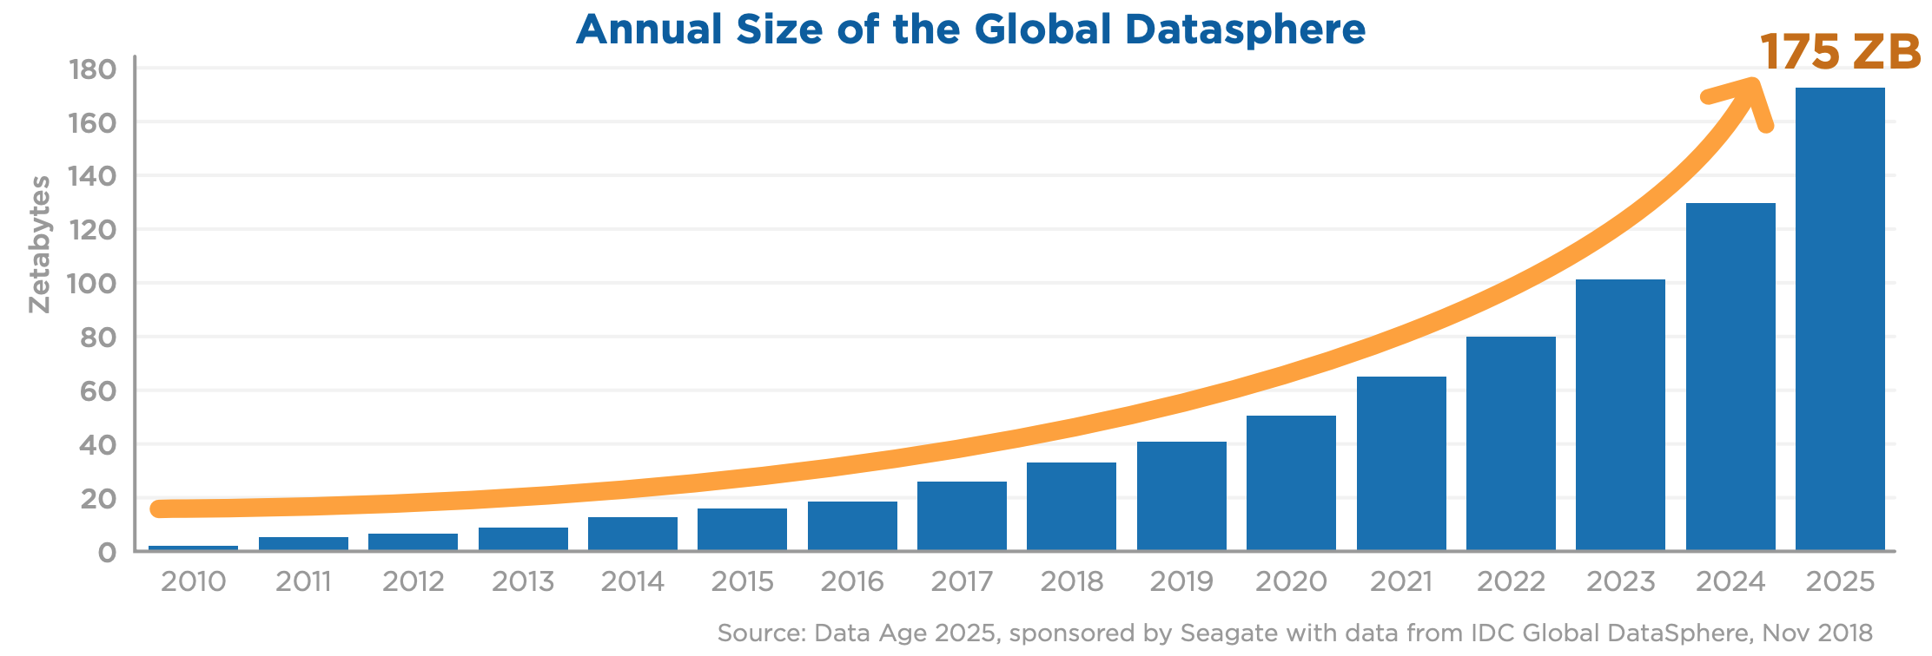
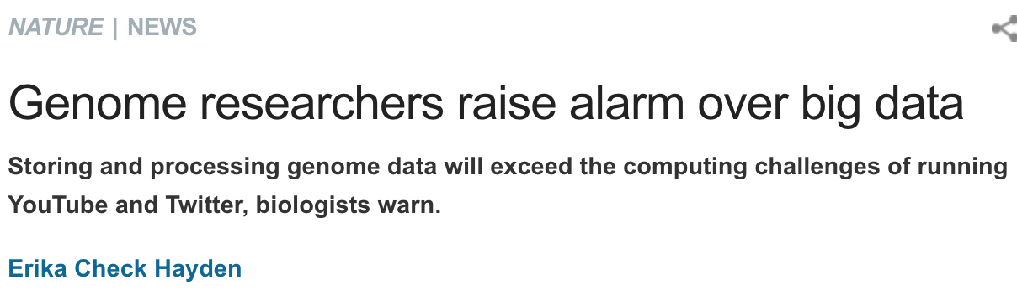
Data Explosion
1 ZB=1billion terabytes

Slide 5
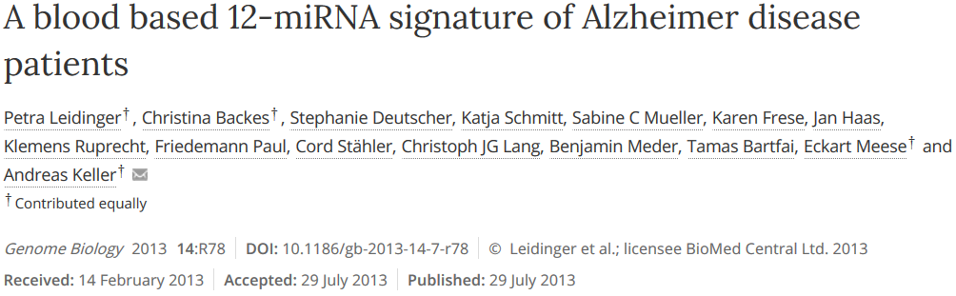
Learn to Diagnose Alzheimers from molecular blood measurements
Given past data:
  Measurements on 70 subjects patients and controls
  503 miRNA expression levels (features)
  Whether they had Alzheimers or not (outcome / labels)
Learn to diagnose the disease on new subjects given the same measurements (predictive and diagnostic modeling)
Identify the molecular quantities that are diagnostic (feature selection)

Slide 6
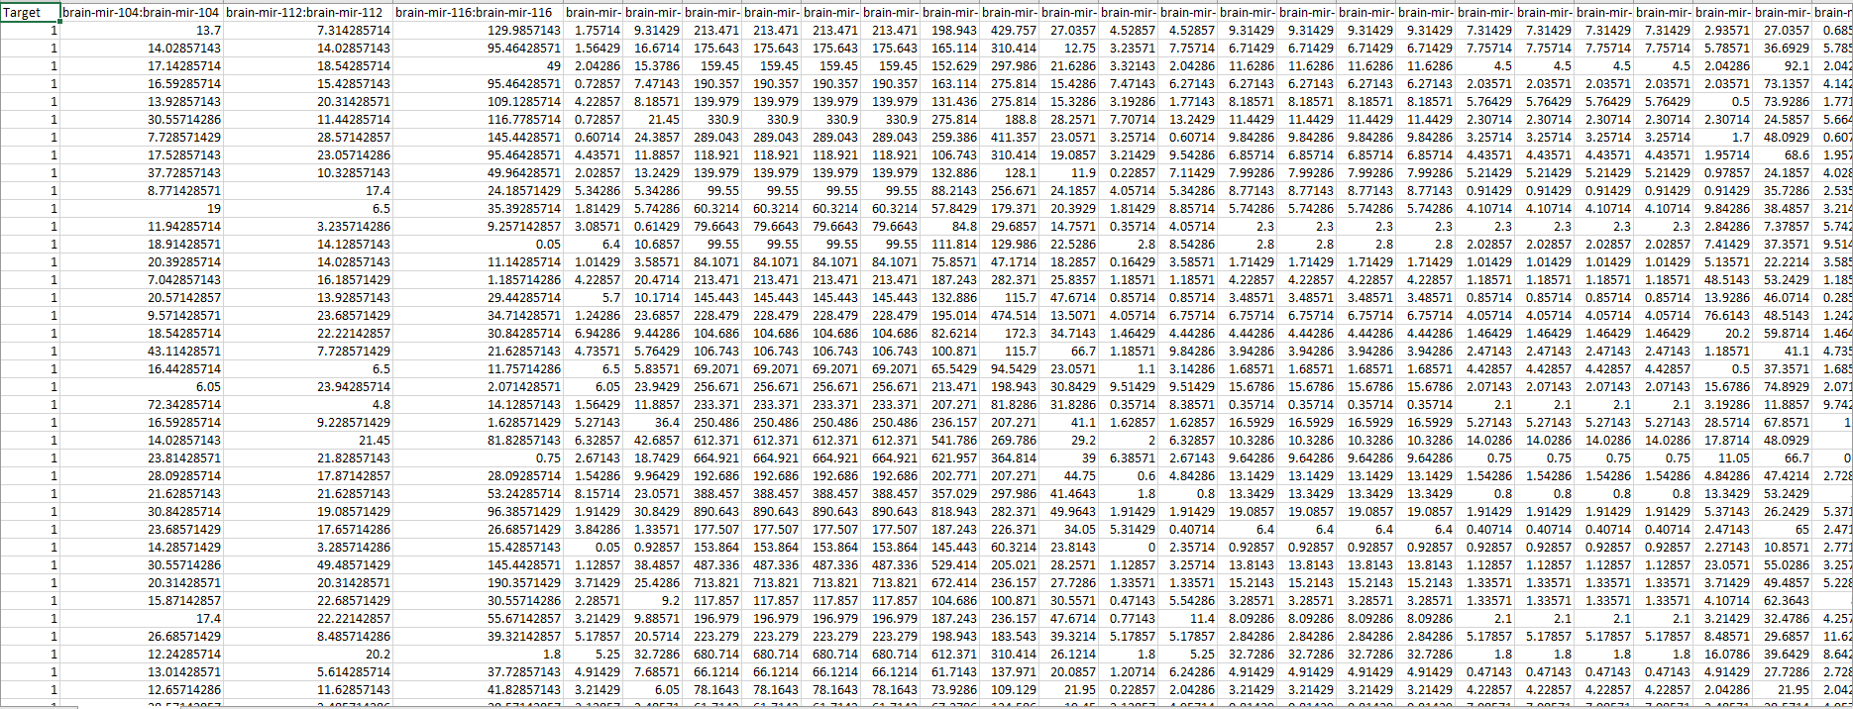
Learn to Diagnose Alzheimers from molecular blood measurements

Slide 7
The Predictive and Diagnostic Modeling Problem
Client data
Subscribers data
Transaction data
Sales data
Website visit data
Fraudulent transaction?
Behavior of client (will they drop their subscription?, will they buy a product?)
Given past examples of objects and their actual outcome of interest, learn a predictive or diagnostic model for new, unseen, objects

Slide 8
The Predictive and Diagnostic Modeling Problem
Micro-array gene expressions
Methylation of CpG cites
Next Generation Sequencing mRNA peaks
SNP
Copy-number variations
Proteomics (mass spectroscopy, LC, etc.)
Metabolomics
Flow-cytometry
Mass-cytometry
Text of biomedical documents
Clinical and Medical Quantities
Environmental exposure factors
Combinations of the above
Disease status (diagnosis)
Response to treatment
Phenotype
Time to death, relapse, complication
Properties of a document
Given past examples of profiles and their actual outcome of interest, learn a predictive or diagnostic model for new, unseen, profiles

Slide 9
Predictive Model example
Rule-Based Model (Decision Tree)
If Gene A is Overexpressed and
Gene C is Underexpressed
Then
  Classify as Lung cancer
Else
  Classify as Healthy
lung cancer
healthy
Gene C
Gene A
Linear Model:
Metastatic = sign ( 0,5 × Gene A – 0,5 × Gene C + 3)
 |  | Expression Values
 |  | Genes
 |  | Gene A | Gene B | Gene C | … | Lung cancer?
Individuals | 1 | 123.00 | 1.00 | 2.3 | … | Yes
 | 2 | 323.00 | 23.00 | 4.54 | … | No
 |  | … | … | … | … | …
 | N | 232.00 | 4,5 | 23.00 |  | Yes

Slide 10
The Data Analysis Process
Data Engineering
Data Engineering and Data Analytics
Data Analytics – Machine Learning
Post-Analysis Phase
Model Production Phase
Model Updating Phase
Data Wrangling
Feature engineering and construction
Transformations
Model Explanation
Model Deployment
Retraining with more samples (records)
Data Cleaning
Imputation
Visualization of results
Monitoring for model invalidation
Retraining with more features
Data Preprocessing
Feature Selection
(Supervised) Anomaly Detection
(Unsupervised) Outlier Detection
Modeling
Performance Estimation

Slide 11
The Data Analysis Process
Data Engineering
Data Engineering and Data Analytics
Data Analytics – Machine Learning
Post-Analysis Phase
Model Production Phase
Model Updating Phase
Data Wrangling
Feature engineering and construction
Transformations
Model Explanation
Model Deployment
Retraining with more samples (records)
Tuning
Selection of algorithms
  Combinations of algorithms
  Algorithms hyper-parameters
Data Cleaning
Imputation
Visualization of results
Monitoring for model invalidation
Retraining with more features
Data Preprocessing
Feature Selection
(Supervised) Anomaly Detection
(Unsupervised) Outlier Detection
Modeling
Performance Estimation

Slide 12
Current Practice: Scripting
---
title: "Update of HUNT RPM & evaluation on new data"
author:
- name: Maria Markaki
affiliation: MXM lab - Computer Science Department, University of Crete
email: maria.g.markaki@gmail.com
output:
BiocStyle::html_document
abstract: |
Random 1 denotes control, without follow-up, which does not get any image diagnostics, nor rtg thorax. Random 2 denotes CT group. Smoking status (Rygestatus) 1: current smokers, 2: ex-smokers. Nelson D group more than 15 cigarettes per day, more than 25 years, less or equal to 10 years quit time, or more than 10 cigarettes per day, more than 30 years, less or equal to 10 yeard quit time, 50 to 75 years age.
vignette: |
%\VignetteIndexEntry{Vignette Title}
%\VignetteEngine{knitr::rmarkdown}
%\VignetteEncoding{UTF-8}
---
# Settting up the working enviroment and loading the data for Danish group of smokers
```{r}
rm(list = ls());
setwd("D:/Dropbox (Personal)/gnosis/HUNT/DanishCohort")
library("rms")
library("mice")
library("mfp")
library("pROC")
library("ROCR")
library("readxl")
library("tidyverse")
library("PredictABEL")
library("Hmisc")
### Other missing values in Danish cohort were set to median values: median cig per day is 20, median pack yrs is 33.75, median age is 57.60, median BMI is 24.76; Danish people have ages between 49-71
## Importation of HUNT Multiple Imputation datasets
load("HUNTfiles/newimp60copy.RData")
load("HUNTfiles/timetoEvent.RData")
load("HUNTfiles/SMARTc.RData")
load("HUNTfiles/ismo.RData")
## Disable scientific notation in scripts R; a problem incurred with alpharithmetic transformed to numeric when an intersection with numeric values was asked for
options(scipen = 999)
Dataset<-SMARTc
event<-Dataset$outcome
sum(event[ismo])
timetoEvent1 <- timetoEvent[ismo]/365.25
event1 <- event[ismo]
sum(event1)
i = which(event1 ==1)
j = which(timetoEvent1[i]<=10)
event10yrs <- event1
event10yrs[-i[j]] <- 0
sum(event10yrs)
timetoEvent10yrs <- timetoEvent1
timetoEvent10yrs[timetoEvent1>10] <- 10
## Train on data from HUNT with the age span of Danish cohort 49-71 and events up to 10 years; try to improve using multiply imputed datasets
Dataset1 <- mice::complete(newimp60,1)
Dataset1[] <- lapply(Dataset1, unclass)
Dataset2 <- Dataset1[c(ismo),c(2,1,4,26,27,34)]
i = which(Dataset2$PartAg.NT2BLQ1 >= 49 & Dataset2$PartAg.NT2BLQ1 <= 71)
length(i)
describe(Dataset2)
timetoEvent10yrsshort <- timetoEvent10yrs[i]
event10yrsshort <- event10yrs[i]
ii = which(event10yrsshort == 1)#227
sum(event10yrsshort)
S <- Surv(timetoEvent10yrsshort,event10yrsshort)
nimp=newimp60$m
Cindeximp=matrix(0,1,nimp)
coef10yrsimp=matrix(0,6,nimp)
riskthresh = matrix(0,1,nimp)
interm = matrix(0,12091,1)
Xbeta10yrsimp <- matrix(0,12091,nimp)
for (j in c(1:nimp)){
Dataset1 <- mice::complete(newimp60,j)
Dataset1[] <- lapply(Dataset1, unclass)
Dataset2 <- Dataset1[c(ismo),c(2,1,4,26,27,34)]
Dataset22 <- Dataset2[c(i), ]
dataset111 <- NULL
dataset111$age <- Dataset22$PartAg.NT2BLQ1
dataset111$Sex <- Dataset22$Sex
dataset111$packyrs <- log(Dataset22$SmoPackYrs.NT2BLQ1+1)
dataset111$ICS <- Dataset22$SmoCigDyN.NT2BLQ1
dataset111$TSC <- log(Dataset22$SmoDyCesDu.NT2BLQ1+1)
dataset111$BMI <- log(Dataset22$BMI)
x1 <- as.data.frame(dataset111)
#x <- x1 %>% select(age,Sex,packyrs, ICS,TSC,BMI) %>% data.matrix()
dd <- datadist(Dataset22)
options(datadist="dd")
IMTOfit0 <- cph(S ~ PartAg.NT2BLQ1 + Sex + log(SmoPackYrs.NT2BLQ1+1) + SmoCigDyN.NT2BLQ1 + log(SmoDyCesDu.NT2BLQ1+1) + log(BMI), data=Dataset22, x=TRUE,y=TRUE,linear.predictors = TRUE)
coef10yrsimp[,j] <- as.numeric(IMTOfit0$coefficients)
interm <- as.matrix(x1)%*%coef10yrsimp[,j]
Xbeta10yrsimp[,j] <- interm
#C-statistic:
res = rcorr.cens(-interm,S)
Cindeximp[j] = res[[1]]
res1 = quantile(interm[ii],probs = c(0.16,0.84))
riskthresh[j] <- res1[[1]]
}
mean(Cindeximp)
median(Cindeximp)
riskthreshold = median(riskthresh)
riskthreshold
mean(riskthresh)
Xbeta10yrs <- rowMeans(Xbeta10yrsimp)
rm(Xbeta10yrsimp)
coef10yrs <- rowMeans(coef10yrsimp)
coef10yrs
```
```{r}
j = which(abs(Xbeta10yrs - riskthreshold)< 0.00003)#1289
Dataset22[j,]#corresponds to a risk of ~2.32% in 16 years; 0.49% in 6 years
# PartAg.NT2BLQ1 Sex SmoPackYrs.NT2BLQ1 SmoDyCesDu.NT2BLQ1 SmoCigDyN.NT2BLQ1 BMI
# 49.2 1 24.3 0 18 29.1
i = which(Xbeta10yrs > riskthreshold)#5407 out of 12091 would be screened
1-0.9978^(exp(riskthreshold))
length(i)
#how many exceed the threshold of 16% quantile of risk of events in HUNT
sum(event10yrsshort[i])
sum(event10yrsshort[i])/sum(event10yrsshort)#% cancers within this group would be detected
#Nelson would choose:
smoyears <- Dataset22$SmoPackYrs.NT2BLQ1*20/Dataset22$SmoCigDyN.NT2BLQ1
i <- which(Dataset22$SmoCigDyN.NT2BLQ1 > 15 & Dataset22$SmoDyCesDu.NT2BLQ1 <= 10 &
Dataset22$PartAg.NT2BLQ1 <= 75 & Dataset22$PartAg.NT2BLQ1 >= 50
& smoyears > 25)#1121
ii <- which(Dataset22$SmoCigDyN.NT2BLQ1 > 10 & Dataset22$SmoDyCesDu.NT2BLQ1 <= 10 &
Dataset22$PartAg.NT2BLQ1 <= 75 & Dataset22$PartAg.NT2BLQ1 >= 50
& smoyears > 30)#1905
sum(event10yrsshort[i])#only 49/227=21.58% events would be found by Nelson1 criteria!
sum(event10yrsshort[ii])#only 78/227=34.36% events would be found by Nelson2 criteria!
#NLST would choose:
i <- which(Dataset22$SmoPackYrs.NT2BLQ1 >= 30 & Dataset22$SmoDyCesDu.NT2BLQ1 <= 15 & Dataset22$PartAg.NT2BLQ1 >= 55)#1152
NLSTnum <- length(i)
sum(event10yrsshort[i])#only 61/227=26.87% events would be found by NLST criteria!
a <- sort(Xbeta10yrs, decreasing = TRUE)
head(a)#4.75
a[NLSTnum]#the cutoff risk threshold in order to select the 1152 highest risk persons;3.106
1-0.9978^(exp(a[NLSTnum]))
linpred<-Xbeta10yrs #12091 HUNT subset
dataset <- as.data.frame(Dataset22)
dataset$event <- event10yrsshort
groups <- 10
predRisk1=1-0.9978^(exp(linpred))
max(predRisk1)
plotCalibration(data = dataset, cOutcome = 7, predRisk=predRisk1, groups=groups, rangeaxis=c(0,0.1))
i = which(event10yrsshort==1)
quantile(predRisk1[i],0.16)
xax <- seq(1,5407,50)
diml <- length(xax)
maxfound <- matrix(nrow = diml, ncol = 1)
j <- 1
for (i in xax)
{
ii = which(Xbeta10yrs >= a[[i]])
maxfound[j] <- sum(dataset$event[ii])
j = j+1
}
cbind(xax,maxfound)
plot(xax,maxfound,xlab="Number of screenings",ylab="Events detected")
predRisk1sort <- sort(predRisk1, decreasing = TRUE)
xax1 <- predRisk1sort[seq(1,5407,50)]
maxfound <- matrix(nrow = diml, ncol = 1)
j <- 1
for (i in xax)
{
ii = which(Xbeta10yrs >= a[[i]])
maxfound[j] <- sum(dataset$event[ii])
j = j+1
}
#0.0136 0.048
plot(maxfound,xax1,xlab="Events detected",ylab="Risk of Lung Cancer within 10 years")
#abline(h=0.0,v=0,col="gray60")
```
## Transform continuous variables in the test set as in the training set
```{r}
load("D:/Dropbox (Personal)/gnosis/HUNT/DanishCohort/DanishCohortComplete.RData")
olufkendelig <- read_excel("olufk?nendelig.xlsx")
names(AA)#complete
unique(AA$random)#2 mean screening, 1 no screening
#examine possible outliers
quantile(AA$age,probs = c(0.01,0.99))#almost coincide with min and max
min(AA$age)
max(AA$age)
quantile(AA$packyrs,probs = c(0.01,0.99))#almost coincide with min and max
min(AA$packyrs)
max(AA$packyrs)
qcig <- quantile(AA$`cig per day`,probs = c(0.01,0.99))#10,40
min(AA$`cig per day`)#0!
max(AA$`cig per day`)#40 coincide with max only
AA$`cig per day`[AA$`cig per day`<qcig[1]]<- qcig[1]# 1 2 35 70 range 2-35
quantile(AA$TSC,probs = c(0.01,0.99))#coincide with min and max
max(AA$TSC)
quantile(AA$BMI,probs = c(0.01,0.99))#coincide with min and max
max(AA$BMI)
## Evaluation results
LCLIST <- read_excel("LCLIST.xlsx")
names(LCLIST)#plus cancer type and tumor stage:
unique(LCLIST$TNM)#T1aN0M0 denotes the smallest tumors with best survival
unique(LCLIST$Rgroup)#Rgroup 1 : no screening#Rgroup 2 : yearly CT screening
LCLIST1 <- LCLIST %>% filter(Rgroup == 1)#53 no screening
LCLIST2 <- LCLIST %>% filter(Rgroup == 2)#101 screening
min(LCLIST$DateDiagnosis)#"2005-02-01 UTC"
max(LCLIST$DateDiagnosis)# "2014-12-29 UTC"
str(AA$id)#char
str(LCLIST$StId)#num
i =which(!is.na(LCLIST$StId))#154, all
length(LCLIST$StId)
length(unique(LCLIST$StId))#149
length(intersect(LCLIST$StId, unique(LCLIST$StId)))#149
AA$id <- as.numeric(AA$id)
LCLIST2nd <- semi_join(LCLIST,AA,by = c("StId" = "id" ))#153
Anew <- left_join(AA,LCLIST2nd, by = c("id" = "StId"))#4087
names(Anew)
i = which(is.na(Anew$`Inclusion date`))#4
ii = which(is.na(Anew$year))#the same as before
Anew2nd <- Anew[-c(i),]
length(unique(Anew2nd$id))
length(Anew2nd$id)
length(intersect(Anew2nd$id, unique(Anew2nd$id)))#4077
Anew2nd$event <- matrix(0,4083,1)
i = which(!is.na(Anew2nd$DateDiagnosis))#153 cancers
Anew2nd$event[i] <- 1
sum(Anew2nd$event)#153
Anew2nd$timetoevent <- matrix(10,4083,1)
Anew2nd$timetoevent[i] <- (Anew2nd$DateDiagnosis[i] - Anew2nd$`Inclusion date`[i])/365
Anew3rd <- Anew2nd[unique(Anew2nd$id),]
names(Anew3rd)
i = which(Anew3rd$event==1)#152
j = which(Anew3rd$random ==1)#2015
id_sex <- intersect(as.numeric(Anew3rd$id),as.numeric(olufkendelig$`Study ID`))#4051 out of 4077
Anew4th <- Anew3rd[id_sex,]
names(Anew4th)#id
names(olufkendelig)#Study ID
Anew4th$id <- as.numeric(Anew4th$id)
olufkendelig$id2 <- as.numeric(olufkendelig$`Study ID`)
Anewth <- left_join(Anew4th,olufkendelig, by = c("id" = "id2"))#4087
sum(Anewth$event,na.rm = TRUE)# 149
Anewth1 <- Anewth %>% filter(random == 1)#1999 no screening
Anewth2 <- Anewth %>% filter(random == 2)#2006 screening
describe(Anewth1)
describe(Anewth2)
#no difference in the two groups; how were they assigned to screening?
LCLIST1 <- Anewth %>% filter(Rgroup == 1 & event ==1)#52 no screening
LCLIST2 <- Anewth %>% filter(Rgroup == 2 & event ==1)#97 screening
i = which(Anewth$packyrs >= 30& Anewth$age >= 55 & Anewth$age <= 74)# 1870
length(i)
sum(Anewth$event[i])#104/149=69.79866% are found by NLST
IInum <- c(i)
length(which(Anewth$random==1&Anewth$event==1))#52 events in those not screened
length(which(Anewth$random==2&Anewth$event==1))#97 events in those screened
#Nelson would choose:
smoyears <- Anewth$packyrs*20/Anewth$`cig per day`
i <- which(Anewth$`cig per day` > 15 & Anewth$TSC <= 10 &
Anewth$age <= 75 & Anewth$age >= 50
& smoyears > 25)#2360
ii <- which(Anewth$`cig per day` > 10 & Anewth$TSC <= 10 &
Anewth$age <= 75 & Anewth$age >= 50
& smoyears > 30)#3350
iii <- which(Anewth$`cig per day` > 10 & Anewth$TSC <= 10 &
Anewth$age <= 75 & Anewth$age >= 50
& smoyears > 30 | (Anewth$`cig per day` > 15 & Anewth$TSC <= 10 &
Anewth$age <= 75 & Anewth$age >= 50
& smoyears > 25))#3590
sum(Anewth$event[i],na.rm = TRUE)# 109/149=73,15% events would be found by Nelson1 criteria!
sum(Anewth$event[ii],na.rm = TRUE)# 141/149=94.63% events would be found by Nelson2 criteria!
sum(Anewth$event[iii],na.rm = TRUE)#141
sum(Anewth$event,na.rm = TRUE)
ii = which(Anewth$packyrs >= 30& Anewth$age >= 55 & Anewth$age <= 74 & Anewth$random==1)#918 were not screened among those selected by NLST
length(ii)
iii = which(Anewth$packyrs >= 30& Anewth$age >= 55 & Anewth$age <= 74 & Anewth$random==1&Anewth$event==1)#35/52 events detected by NLST 67.30% in those not screened
length(iii)
iv = which(Anewth$packyrs >= 30& Anewth$age >= 55 & Anewth$age <= 74 & Anewth$random==2)#952 were screened among those selected by NLST
length(iv)
ivv = which(Anewth$packyrs >= 30& Anewth$age >= 55 & Anewth$age <= 74 & Anewth$random==2&Anewth$event==1)#69/97 events detected by NLST 71.11% in those screened
length(ivv)
#69 are common between the 1870 persons selected by NLST and the 97 cancers that were screened
#35 are common between the 1870 persons selected by NLST and the 52 cancers not screened
#Nelson performance in not screened; Nelson would choose:
ii <- which(Anewth$`cig per day` > 10 & Anewth$TSC <= 10 &
Anewth$age <= 75 & Anewth$age >= 50
& smoyears > 30& Anewth$random==1)#1668 selected by Nelson
length(which(Anewth$random==1&Anewth$event==1))#52 events in those not screened
iii = which(Anewth$`cig per day` > 10 & Anewth$TSC <= 10 &
Anewth$age <= 75 & Anewth$age >= 50
& smoyears > 30& Anewth$random==1&Anewth$event==1)#47/52 events detected by Nelson
length(iii)
sum(Anewth$event[ii],na.rm = TRUE)
#max 10 years; so I need to train a Cox model for 10 years
testset <- NULL
testset$age <- Anewth$age
testset$Sex <- Anewth$Sex
testset$packyrs <- log(Anewth$packyrs+1)
testset$ICS <- Anewth$`cig per day`
testset$TSC <- log(Anewth$TSC+1)
testset$BMI <- log(Anewth$BMI)
x1D <- as.data.frame(testset)
#xD <- x1D %>% select(age,Sex,packyrs, ICS,TSC, BMI) %>% data.matrix()
testset1 <- NULL
testset1$age <- Anewth1$age
testset1$Sex <- Anewth1$Sex
testset1$packyrs <- log(Anewth1$packyrs+1)
testset1$ICS <- Anewth1$`cig per day`
testset1$TSC <- log(Anewth1$TSC+1)
testset1$BMI <- log(Anewth1$BMI)
x1D1 <- as.data.frame(testset1)
#xD1 <- x1D1 %>% select(age,Sex,packyrs, ICS,TSC, BMI) %>% data.matrix()
testset2 <- NULL
testset2$age <- Anewth2$age
testset2$Sex <- Anewth2$Sex
testset2$packyrs <- log(Anewth2$packyrs+1)
testset2$ICS <- Anewth2$`cig per day`
testset2$TSC <- log(Anewth2$TSC+1)
testset2$BMI <- log(Anewth2$BMI)
x1D2 <- as.data.frame(testset2)
#xD2 <- x1D2 %>% select(age,Sex,packyrs, ICS,TSC, BMI) %>% data.matrix()
quantile(Anewth1$age,probs = c(0.16,0.50,0.84))#52.19,57.45,62.97
quantile(Anewth2$age,probs = c(0.16,0.50,0.84))#52.,57.73,63.
quantile(Anewth1$packyrs,probs = c(0.16,0.50,0.84))#24.,33.,47
quantile(Anewth2$packyrs,probs = c(0.16,0.50,0.84))#24.46,34.,47.
quantile(Anewth1$BMI,probs = c(0.16,0.50,0.84))#
quantile(Anewth2$BMI,probs = c(0.16,0.50,0.84))#
quantile(Anewth1$TSC,probs = c(0.16,0.50,0.84))#0 0 1
quantile(Anewth2$TSC,probs = c(0.16,0.50,0.84))#0 0 1
quantile(Anewth1$`cig per day`,probs = c(0.16,0.50,0.84))#14.,20.,25
quantile(Anewth2$`cig per day`,probs = c(0.16,0.50,0.84))#15.,20.,25.
sum(Anewth1$Sex)#1092/1999#54.63%
sum(Anewth2$Sex)#1124/2006#56.03%
sum(Anewth1$event)#52 34.9%
sum(Anewth2$event)#97 65.1%
#inverse engineering just for checking:
S_D <- Surv(Anewth$timetoevent,Anewth$event)
S_D1 <- Surv(Anewth1$timetoevent,Anewth1$event)
S_D2 <- Surv(Anewth2$timetoevent,Anewth2$event)
fullxCoxD <- cph(S_D~as.matrix(x1D), x=TRUE,y=TRUE,linear.predictors = TRUE)
fullxCoxD
# age sex packyrs ICS TSC BMI
#0.0682 0.0479 1.2066 -0.03315 -0.2667 -1.4879 HUNT
#0.0386 -0.4698 3.3358 -0.1085 -0.0755 -0.5103 (nor TSC nor BMI are important in Danish cohort!)
fullxCoxD1 <- cph(S_D1~as.matrix(x1D1), x=TRUE,y=TRUE,linear.predictors = TRUE)
fullxCoxD1#significant pack years, BMI; only marginally sex
fullxCoxD1$coefficients
# age Sex packyrs ICS TSC BMI
# 0.05678260 -0.49525427 2.81704860 -0.06180121 -0.34045621 -2.34643791
dd <- datadist(x1D2)
options(datadist="dd")
fullxCoxD2 <- cph(S_D2~as.matrix(x1D2), x=TRUE,y=TRUE,linear.predictors = TRUE)
fullxCoxD2#significant sex, packyrs, number of cigarettes daily
fullxCoxD2$coefficients
# age Sex packyrs ICS TSC BMI
# 0.02529520 -0.45143158 3.82842334 -0.14951066 0.03795531 0.49941983
anova(fullxCoxD2)
testsetUn <- Anewth[,c(5,22,8,7,13,9)]
names(testsetUn)
names(testsetUn) <- c("age","Sex","packyrs","ICS","TSC","BMI")
dd <- datadist(testsetUn)
options(datadist="dd")
IMTOfitD <- cph(S_D ~ age+Sex+log(packyrs+1)+ICS+log(TSC+1)+log(BMI), data=testsetUn,x=TRUE,y=TRUE,linear.predictors = TRUE)
IMTOfitD
sD <- anova(IMTOfitD)
sD
plot(sD, margin=c('chisq', 'proportion chisq'))
testsetUn1 <- Anewth1[,c(5,22,8,7,13,9)]
names(testsetUn1)
names(testsetUn1) <- c("age","Sex","packyrs","ICS","TSC","BMI")
dd <- datadist(testsetUn1)
options(datadist="dd")
IMTOfitD1 <- cph(S_D1 ~ age+Sex+log(packyrs+1)+ICS+log(TSC+1)+log(BMI), data=testsetUn1,x=TRUE,y=TRUE,linear.predictors = TRUE)
IMTOfitD1
sD1 <- anova(IMTOfitD1)
sD1
plot(sD1, margin=c('chisq', 'proportion chisq'))
testsetUn2 <- Anewth2[,c(5,22,8,7,13,9)]
names(testsetUn2)
names(testsetUn2) <- c("age","Sex","packyrs","ICS","TSC","BMI")
dd <- datadist(testsetUn2)
options(datadist="dd")
IMTOfitD2 <- cph(S_D2 ~ age+Sex+log(packyrs+1)+ICS+log(TSC+1)+log(BMI), data=testsetUn2,x=TRUE,y=TRUE,linear.predictors = TRUE)
IMTOfitD2
sD2 <- anova(IMTOfitD2)
sD2
plot(sD2, margin=c('chisq', 'proportion chisq'))
```
```{r}
coef10yrsD <- IMTOfitD$coefficients# c(0.0386,-0.4698 3.3358,-0.1085,-0.0755,-0.5103)#Values
Xbeta10yrsD <- as.matrix(x1D)%*%coef10yrsD
#C-statistic:
rcorr.cens(-Xbeta10yrsD,S_D)#0.7085 !!!
coef10yrsD1 <- fullxCoxD1$coefficients
Xbeta10yrsD1 <- as.matrix(x1D1)%*%coef10yrsD1
#C-statistic:
rcorr.cens(-Xbeta10yrsD1,S_D1)#0.743356
coef10yrsD2 <- fullxCoxD2$coefficients
Xbeta10yrsD2 <- as.matrix(x1D2)%*%coef10yrsD2
#C-statistic:
rcorr.cens(-Xbeta10yrsD2,S_D2)#0.6993!!!
#how many exceed the threshold of 16% quantile of risk of events within 10 years in HUNT
i = which(Xbeta10yrsD >= riskthreshold)
length(i)#4005 out of 4051 would be chosen for screening...
sum(Anewth$event[i])#149; all of them
sum(Anewth$event,na.rm = TRUE)
i=which(!is.na(Anewth$event))#4005
i=which(is.na(Anewth$event))#empty
names(Xbeta10yrsD) <- row.names(Anewth)
#sort Xbeta10yrsD and take top 1870 to compare to NLST
a <- sort(Xbeta10yrsD, decreasing = TRUE)
head(a)
a[1870]#the cutoff risk threshold in order to select the 1870 highest risk persons;10.1935
aaax <- names(a)[1:1870]
unique(as.numeric(LCLIST$StId))#149!
#if I train on Danish cohort I can beat NLST
aaax <- names(a)[1:1870]
i = which(Xbeta10yrsD >= a[[1870]])#1870
sum(Anewth$event[i])#113/149!!!!
```
## Apply on the Danish cohort the model trained in HUNT
```{r}
Xbeta10yrsDr <- as.matrix(x1D)%*%coef10yrs
#C-statistic:
rcorr.cens(-Xbeta10yrsDr,S_D)#0.66345
#sort Xbeta10yrsD and take top 1870 to compare to NLST
#how many exceed the threshold of 16% quantile of risk of events within 10 years in HUNT
i = which(Xbeta10yrsDr >= riskthreshold)#3845 could change
length(i)
ii = which(Xbeta10yrsDr >= riskthreshold & Anewth$random==2&Anewth$event==1)#95 could change
length(ii)
ii = which(Xbeta10yrsDr >= riskthreshold & Anewth$random==2)#1920 could change
length(ii)
ii = which(Xbeta10yrsDr >= riskthreshold & Anewth$random==1&Anewth$event==1)#51/52
length(ii)
ii = which(Xbeta10yrsDr >= riskthreshold & Anewth$random==1)#1925 could change
length(ii)
dataset <- as.data.frame(testsetUn)
linpred <- Xbeta10yrsDr
i=which(is.na(Anewth$event))#46
Anewth$event[i] <- 0
dataset$event <- Anewth$event
sum(dataset$event)
groups <- 10
predRisk1=1-0.9978^(exp(linpred))
max(predRisk1, na.rm = TRUE)#0.2106
#Calibration in the Danish group
plotCalibration(data = dataset, cOutcome = 7, predRisk=predRisk1, groups=groups, rangeaxis=c(0,0.1))
median(predRisk1,na.rm = TRUE)#0.0344
i = which(Anewth$event==1)
quantile(predRisk1[i],0.16)#2.7%
ii = which(predRisk1 >= quantile(predRisk1[i],0.16))#2642 screenings
sum(Anewth$event[ii])#125
sum(Anewth$event[ii])/sum(Anewth$event)#83.9%
```
```{r}
Xbeta10yrsDr1 <- as.matrix(x1D1)%*%coef10yrs
#C-statistic:
rcorr.cens(-Xbeta10yrsDr1,S_D1)#0.7092
linpred1 <- Xbeta10yrsDr1
dataset1 <- as.data.frame(testsetUn1)
dataset1$event <- Anewth1$event
sum(dataset1$event)
groups <- 10
predRisk11=1-0.9978^(exp(linpred1))
max(predRisk11, na.rm = TRUE)#0.18
#Calibration in the Danish group 1
plotCalibration(data = dataset1, cOutcome = 7, predRisk=predRisk11, groups=groups, rangeaxis=c(0,0.1))
median(predRisk11,na.rm = TRUE)
```
```{r}
Xbeta10yrsDr2 <- as.matrix(x1D2)%*%coef10yrs
#C-statistic:
rcorr.cens(-Xbeta10yrsDr2,S_D2)#0.6382
linpred2 <- Xbeta10yrsDr2
dataset2 <- as.data.frame(testsetUn2)
dataset2$event <- Anewth2$event
sum(dataset2$event)
groups <- 10
predRisk12=1-0.9978^(exp(linpred2))
max(predRisk12, na.rm = TRUE)
#Calibration in the Danish group 2
plotCalibration(data = dataset2, cOutcome = 7, predRisk=predRisk12, groups=groups, rangeaxis=c(0,0.1))
median(predRisk12,na.rm = TRUE)
```
```{r}
Anewth$risk <- Xbeta10yrsDr
Anewth1 <- Anewth %>% filter(random == 1)
Anewth2 <- Anewth %>% filter(random == 2)
Anewth1$risk <- Xbeta10yrsDr1
i = which(Xbeta10yrsDr >= riskthreshold)#3921/3845 out of 4051 would be chosen for screening...
length(i)
sum(Anewth$event[i])#148/146
i = which(Anewth1$risk >= riskthreshold)#1925
length(i)
sum(Anewth1$event[i])#51/52
i = which(Anewth2$risk >= riskthreshold)
length(i)
sum(Anewth2$event[i])#97/97/95
i = which(Xbeta10yrsDr >= 2.2)#3386 142
length(i)
sum(Anewth$event[i])
i = which(Xbeta10yrsDr >= 2.3)#3170
length(i)
sum(Anewth$event[i])#140/149,
names(Xbeta10yrsDr) <- row.names(Anewth)
a1 <- sort(Xbeta10yrsDr1, decreasing = TRUE)
head(a1)
a1[1668]#the cutoff risk threshold in order to select the 1668 highest risk persons;2.225
i = which(Xbeta10yrsDr1 >= a1[[1668]])
sum(Anewth1$event[i],na.rm = TRUE)#50
i = which(Xbeta10yrsDr1 >= a1[[1350]])
sum(Anewth1$event[i],na.rm = TRUE)#47
i = which(Xbeta10yrsDr1 >= a1[[1300]])
sum(Anewth1$event[i],na.rm = TRUE)#47
#35 events as NLST
i = which(Xbeta10yrsDr1 >= a1[[709]])
sum(Anewth1$event[i],na.rm = TRUE)#
a <- sort(Xbeta10yrsDr, decreasing = TRUE)
head(a)
a[1870]#the cutoff risk threshold in order to select the 1870 highest risk persons;2.804
a[3100]
i = which(Xbeta10yrsDr >= a[[3100]])
sum(Anewth$event[i],na.rm = TRUE)
1-0.9978^(exp(a[3100]))#2.24% vs 2.7% from quantile of events
1-0.9978^(exp(a[1870]))#3.57% risk within 10 years
aaax <- names(a)[1:1870]
i = which(Xbeta10yrsDr >= a[[1870]])#1870
sum(Anewth$event[i])#101/149!!!!
a1 <- sort(Xbeta10yrsDr1, decreasing = TRUE)
head(a1)
a1[918]#the cutoff risk threshold in order to select the 1870 highest risk persons;2.8023
1-0.9978^(exp(a1[918]))#3.565% risk within 10 years
aaax <- names(a1)[1:918]
i = which(Xbeta10yrsDr1 >= a1[[918]])#918
sum(Anewth1$event[i])#40/52
i = which(Xbeta10yrsDr1 >= a[[1870]])#917
sum(Anewth1$event[i],na.rm = TRUE)#40
sum(Anewth1$event)#52
40/52#0.76923
#Better model performance in Rgroup == 1
#because only in this group quit time and BMI significantly reduce lung cancer risk
#In contrary, in the second group, quit time and BMI are insignificant.
#In both groups, contrary to the HUNT model, female gender has higher risk
i = which(Xbeta10yrsDr2 >= a[[918]])#467
sum(Anewth2$event[i])#39
sum(Anewth2$event)#97
39/97#0.402
xax <- seq(1,3501,50)
diml <- length(xax)
maxfound <- matrix(nrow = diml, ncol = 1)
j <- 1
for (i in xax)
{
ii = which(Xbeta10yrsDr >= a[[i]])
maxfound[j] <- sum(Anewth$event[ii])
j = j+1
}
plot(xax,maxfound,xlab="Number of screenings",ylab="Events detected")
predRisk1sort <- sort(predRisk1, decreasing = TRUE)
xax1 <- predRisk1sort[seq(1,3501,50)]
diml <- length(xax1)
maxfound <- matrix(nrow = diml, ncol = 1)
j <- 1
for (i in seq(1,3501,50))
{
ii = which(Xbeta10yrsDr >= a[[i]])
maxfound[j] <- sum(Anewth$event[ii])
j = j+1
}
plot(maxfound,xax1,xlab="Events detected",ylab="Risk of Lung Cancer within 10 years")
#abline(h=0.0,v=0,col="gray60")
i = which(Anewth$packyrs >= 30& Anewth$age >= 55 & Anewth$age <= 74)# 1870; 26)#2571;3132!
sum(Anewth$event[i])#104/149 are found by NLST
i = which(Anewth1$packyrs >= 30& Anewth1$age >= 55 & Anewth1$age <= 74)#918
sum(Anewth1$event[i])#35/52 are found by NLST
```

Slide 13

What is Automated Machine Learning
“Automated machine learning (AutoML) is the process of automating the end-to-end process of applying machine learning to real-world problems.” Wikipedia
Very hot area of research!
AUT
-ML

Slide 14
AutoML
Input
Predictors / features
ID | x₁ | x₂ | x₃ | x₄ | …. | x_{m} | target
1 | 26 | 0 | 0.3 | 0.06 | … | 2 | yes
2 | 52 | 1 | 2.3 | 0.1 | … | 2 | no
… | … | … | … | … | … | …
n | 34 | 0 | 5.8 | 0.04 | … | 3 | no

Slide 15
AutoML
Input
Predictors / features
ID | x₁ | x₂ | x₃ | x₄ | …. | x_{m} | target
1 | 26 | 0 | 0.3 | 0.06 | … | 2 | yes
2 | 52 | 1 | 2.3 | 0.1 | … | 2 | no
… | … | … | … | … | … | …
n | 34 | 0 | 5.8 | 0.04 | … | 3 | no
instances

Slide 16

AutoML
Input
Auto-ML System
Predictors / features
ID | x₁ | x₂ | x₃ | x₄ | …. | x_{m} | target
1 | 26 | 0 | 0.3 | 0.06 | … | 2 | yes
2 | 52 | 1 | 2.3 | 0.1 | … | 2 | no
… | … | … | … | … | … | …
n | 34 | 0 | 5.8 | 0.04 | … | 3 | no
instances

Slide 17

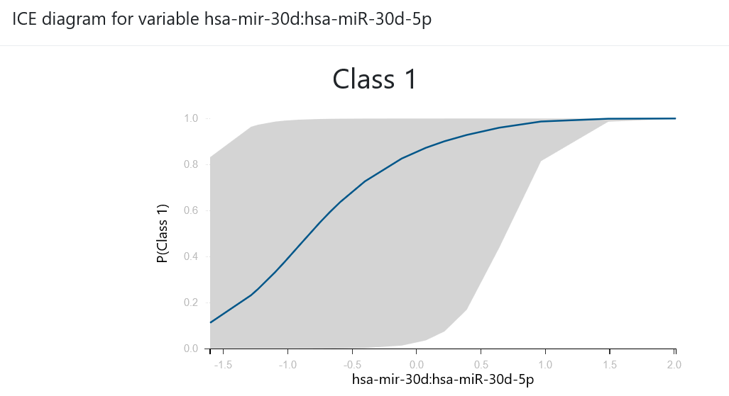
AutoML
Input
Auto-ML System
Output
Predictors / features
ID | x₁ | x₂ | x₃ | x₄ | …. | x_{m} | target
1 | 26 | 0 | 0.3 | 0.06 | … | 2 | yes
2 | 52 | 1 | 2.3 | 0.1 | … | 2 | no
… | … | … | … | … | … | …
n | 34 | 0 | 5.8 | 0.04 | … | 3 | no
Model
instances
x4
x59
x54
y
n
y
n
Explanations

Slide 18
Messages
Predictive analysis is complex, requires expertise, and takes time
We have more data than we can analyze
AutoML tries to automate it

Slide 19
Building AutoML

Slide 20
Challenge: What are the choices?

Slide 21
Challenge: Which algorithms to try?
Business data : tens of millions of transaction, hundreds of features
Molecular Biological Measurements: dozens of patient records, millions of features
Solution 1: Represent the knowledge of expert analysts in AI Decision Support Systems
Solution 2: Learn the knowledge applying ML on results of ML analyses (meta-level learning)

Slide 22
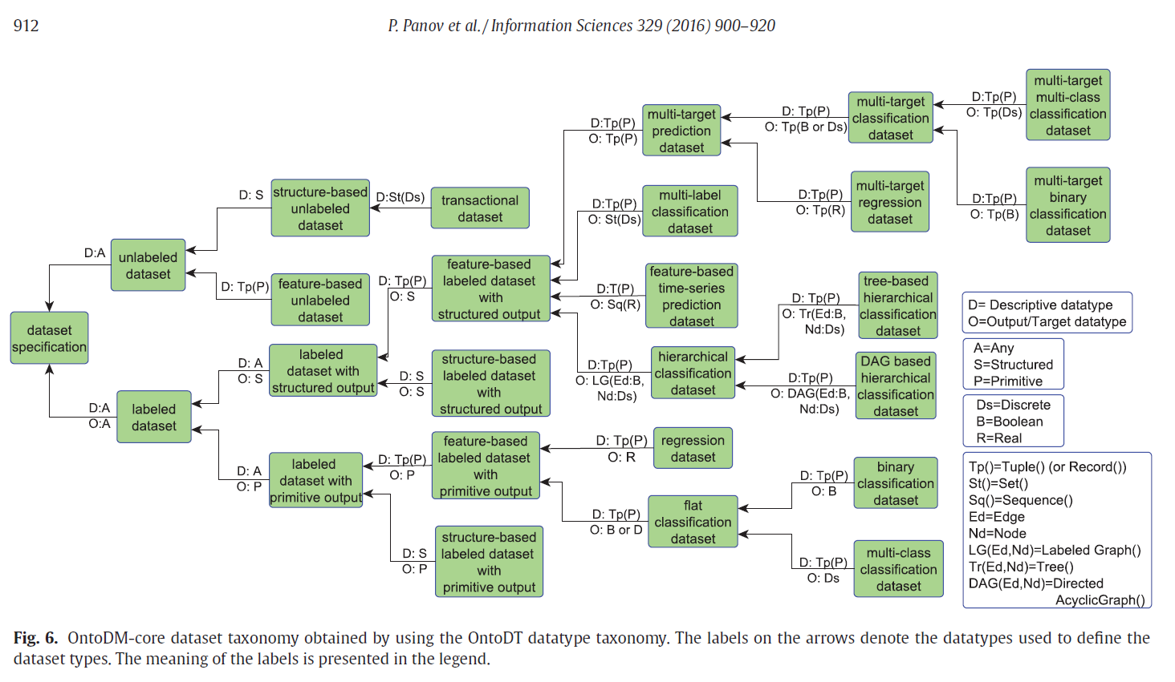
Knowledge Bases-KB
KB are usually composed by ontologies and rules
IF task=classification THEN algorithm=RandomForest

Slide 23
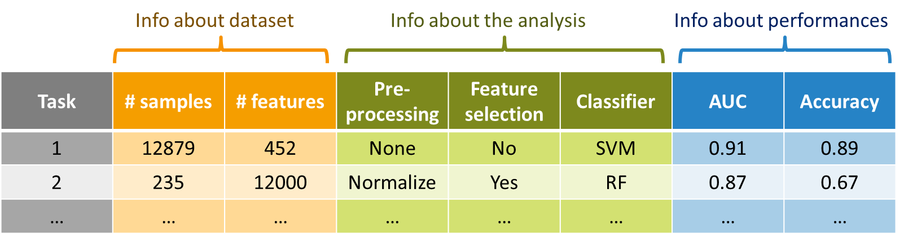

ML to improve ML analyses
Meta-learning or Meta-Level learning: apply ML to predict which method/pipeline will lead to the best model
Sample Size
<=20000
>20000
Use RF
…
Yes
No
Good Performance
Bad Performance
ML Engine

Slide 24
Challenge: Optimize choices

Slide 25
Hyper-Parameters
Algorithms typically accept hyper-parameters
  They affect the sensitivity of identifying patterns and correlations
The choice of the algorithm to use is also a hyper-parameter!
Parameters of a model: learnt from the data
Hyper-parameters of an algorithm: set by the user

Slide 26
Hyper-Parameters and Configurations
Configuration: an instantiation of all choices of a pipeline (values of hyper-parameters)
A configuration completely defines which computations to perform all the way from data to model.

Slide 27

The Concept of a Configuration of the Pipeline
Feature selection
SVM
Random Forest
Ridge Regression
Configuration | Hyper-parameter 1 | Hyper-parameter 2 | …. | Hyper-parameter m-1 | Hyper-parameter m
1 | SES | 0.05 | … | SVM | 2
2 | Lasso | 1 | … | Random Forests | 500
… | … | … | … | … | …
n | … | … | … | … | …

Slide 28
Evaluating single configurations
Train
Tune
An out-of-sample estimation protocol is preferred e.g.:
    hold-out: do it once
    cross validation: partition data to multiple Tune sets (folds), repeat, and average

Slide 29
Optimize hyper-parameters
Typical search strategies
Grid search: static
Random search: dynamic, but naïve
Optimization methods:
  Bayesian optimization, dynamic
Difference from standard optimization: the objective function has uncertainty!

Slide 30
Grid search
Predefine values for each hyperparameter: α∈{0.01, 0.05, 0.1}
Explore the Cartesian product of values
Good
Performance
Simple example:
  2 real-value hyper-parameters
  5 values to investigate per each hyper-parameter
  25 configurations in total
Hyper-parameter 2
Poor
Performance
Hyper-parameter 1

Slide 31
Random search
Select value combinations at random within some ranges until some criterion (e.g., time limit) is satisfied
Good
Performance
Hyper-parameter 2
Hyper-parameter 1
Poor
Performance

Slide 32
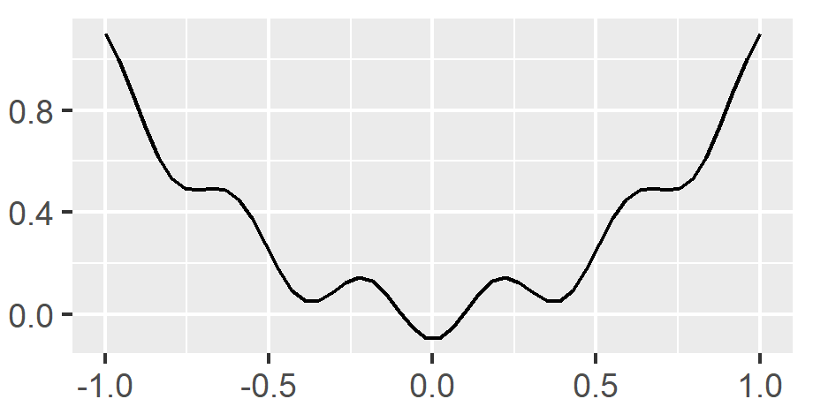


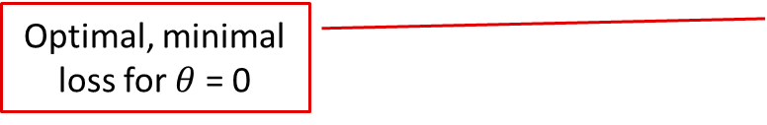
Bayesian Optimization example
A single hyper-parameter $θ$
The performance is computed in terms of loss L
The function $Φ:x→y$ is unknown and must be estimated
L
Optimal, minimal loss for $θ$ = 0
$$θ$$

Slide 33
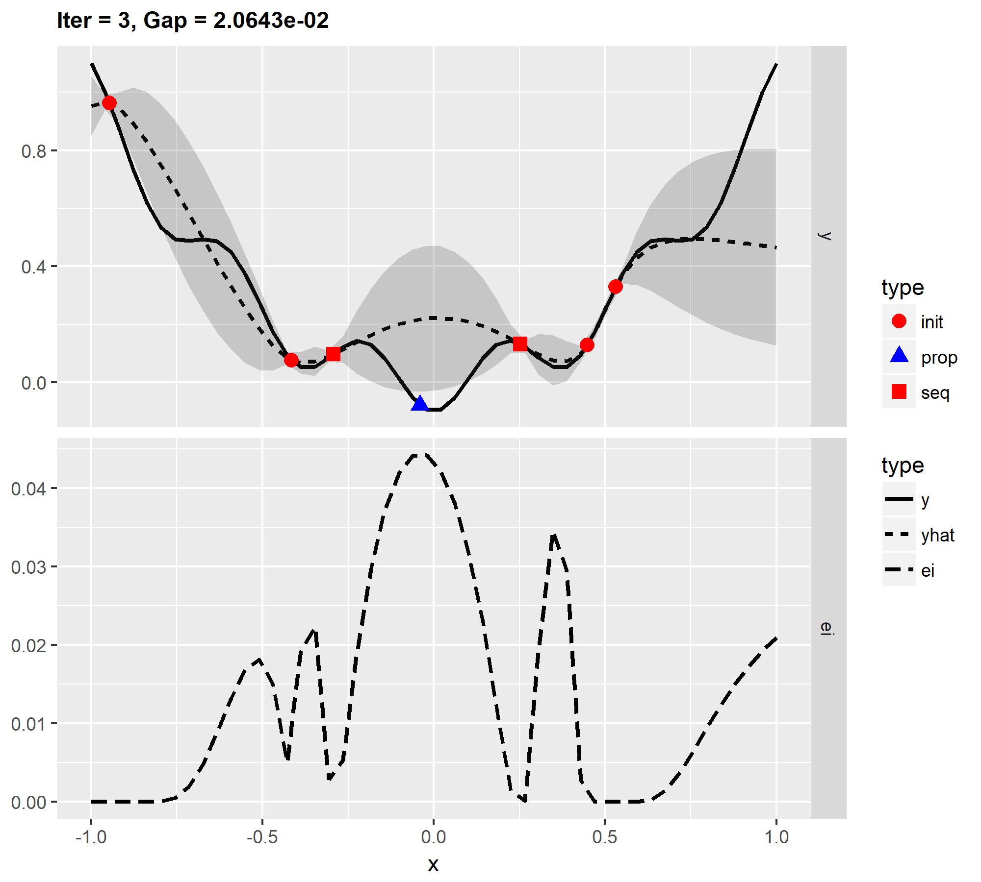
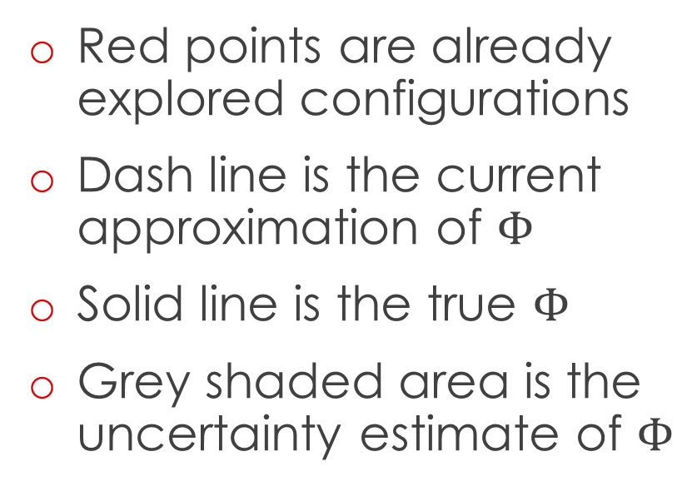

BO operation at iteration i = 7
Red points are already explored configurations
Dash line is the current approximation of $Φ$
Solid line is the true $Φ$
Grey shaded area is the uncertainty estimate of $Φ$
L
$$θ$$

Slide 34
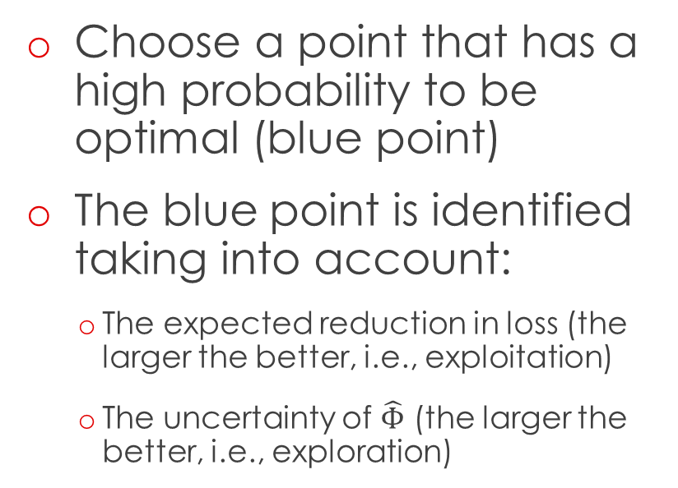
BO operation at iteration i = 7
Choose a point that has a high probability to be optimal (blue point)
The blue point is identified taking into account:
    The expected reduction in loss (the larger the better, i.e., exploitation)
    The uncertainty of $\hat{Φ}$ (the larger the better, i.e., exploration)
L
$$θ$$

Slide 35
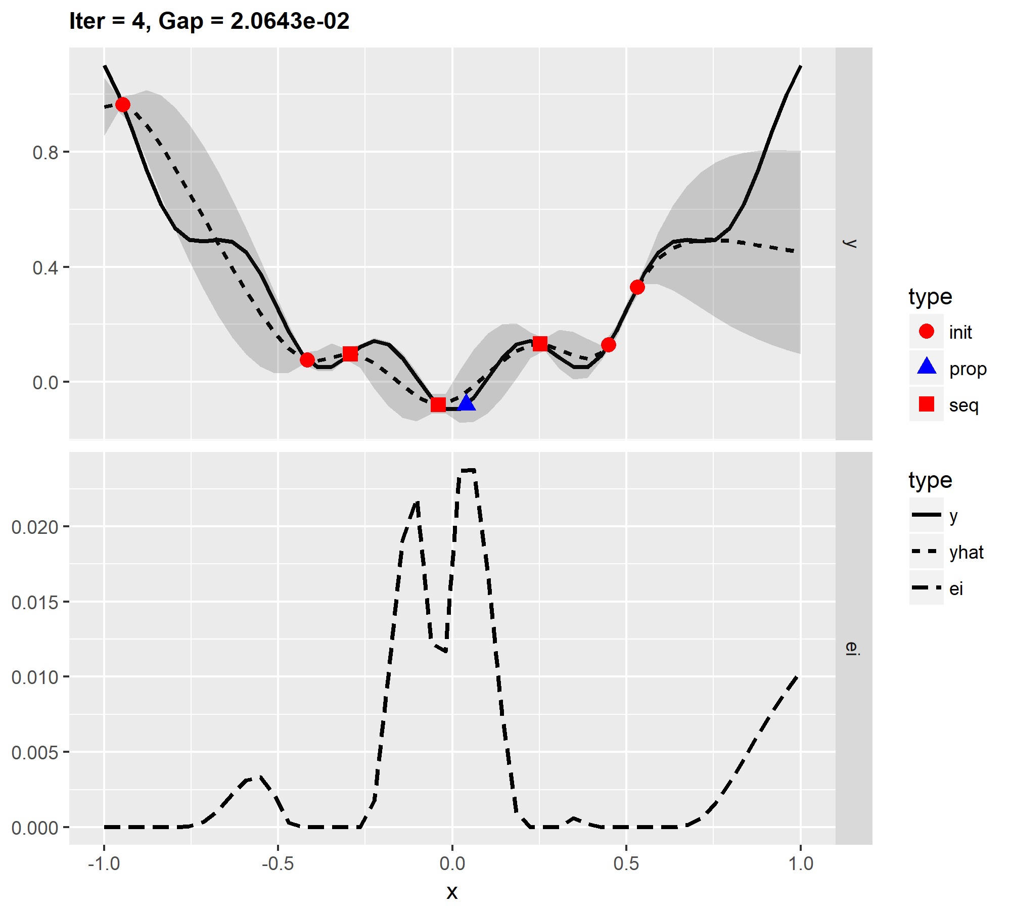
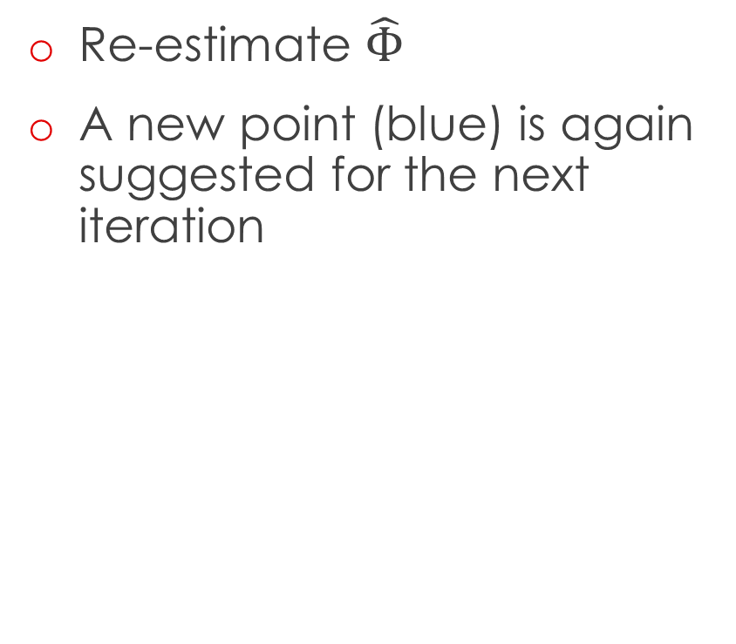
BO operation at iteration i = 8
Re-estimate $\hat{Φ}$
A new point (blue) is again suggested for the next iteration
L
$$θ$$

Slide 36
Take Home Message
Tuning good algorithms is more important than trying more algorithms (personal opinion)
  Average performance improvement of 45% [Thornton et al., Auto-WEKA, 2013]
Tuning of hyper-parameters is a hot area of research

Slide 37
Challenge: Estimate Performance

Slide 38


Estimate Performance
How to estimate the performance of the best configuration?
Can I return the cross-validated performance of the best configuration?
No! The Cross-Validated estimate of the best configuration is optimistic!
(multiple induction problem)

Slide 39
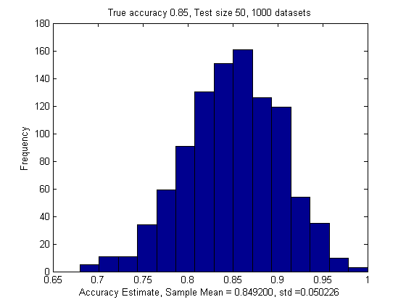

Extreme Distributions: 1 Model
Train
Tune
Alg | Parameter | Loss
K-NN | K=1
Assume:
Equal true accuracies 85%
Mean = 0.85
$$std=\frac{\sqrt{Np\left(1−p\right)}}{N}=0.0505$$

Slide 40
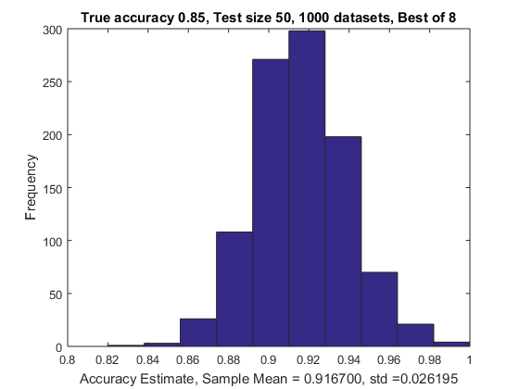
Extreme Distributions: 8 Models
Train
Tune
Alg | Parameter | Loss
K-NN | K=1
 | K=2
 | K=5
DT | MaxPChance=0.01
 | MaxPChance=0.05
 | MaxPChance=0.1
SB | l = 0
 | l=1
Assume: Equal true accuracies 85%Mean,
Std follow an Extreme Distribution

Slide 41
Choose Model AND Estimate Performance
Train
Tune
Estimate
Train: used to train model
Tune: used to choose best configuration (used multiple times)
Estimate: used to estimate performance (used once!)
Called Train-Validation-Test in the literature
Cross-Validation becomes Nested Cross-Validation
  For each possible “Estimate” fold, do a cross-validation

Slide 42
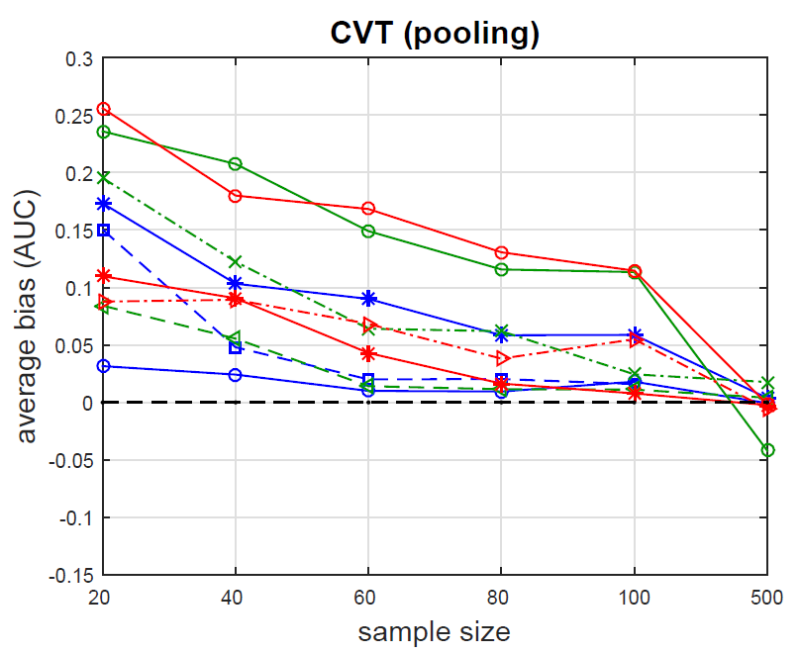
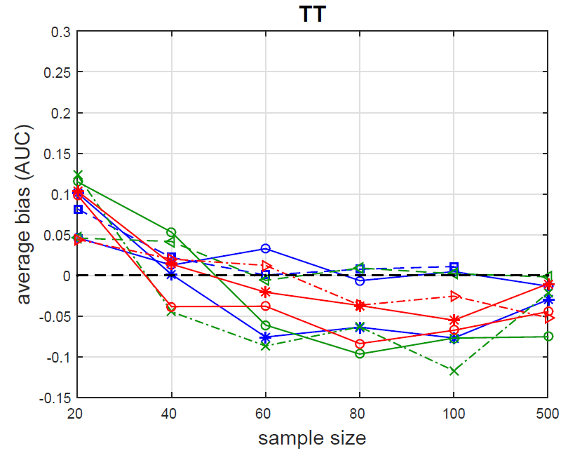
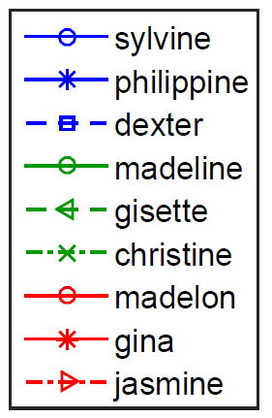
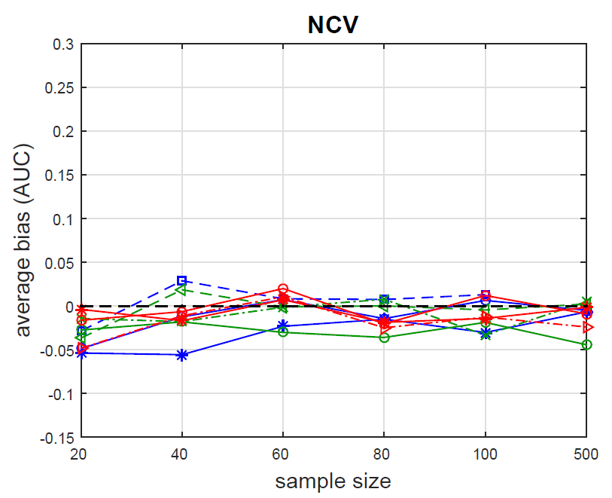
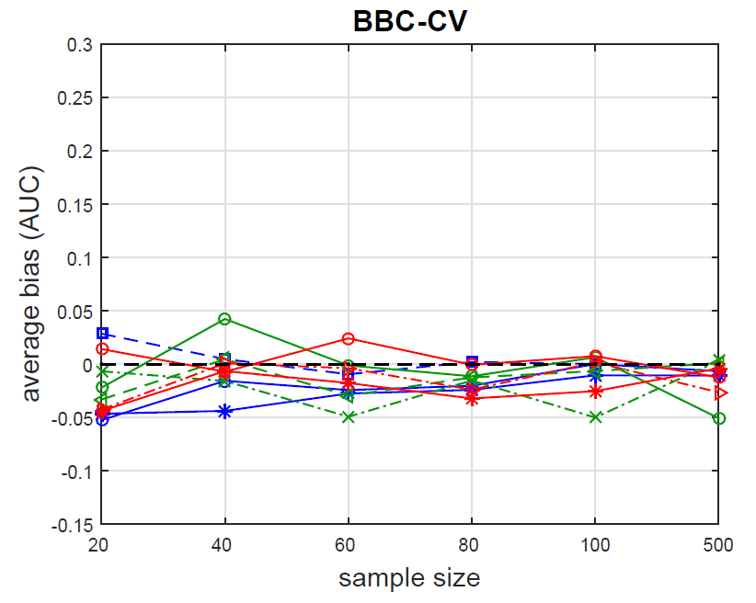
Cross Validation bias correction
Cross Validation With Tuning - CVT
Tibshirani and Tibshirani Protocol - TT
Average estimated bias (over 20 sub-datasets for each original dataset) of the CVT, TT, NCV and BBC-CV estimates of performance.
CVT is optimistically biased for sample size N ≤ 100.
NCV and BBC-CV, both have low bias though results vary with dataset.
Nested Cross Validation - NCV
Bootstrap Bias Corrected Cross-Validation – BBC-CV

Slide 43
Let’s Focus on Selection
Configurations f_{i}
Data D
Test set prediction matrix Π
CV(f₁, D)
Sample | f₁ | f₂ | …. | f_{n}
1 | yes | no | … | no
2 | no | yes | … | no
… | … | … | … | …
224 | no | yes | … | yes
Retrain on all data using best configuration
CV(f₂, D)
Select-Best
CV(f_{n}, D)
Choose the column with the lowest loss
Output best configuration
Π_{ij} = prediction of model trained with configuration j on sample i, when i was in the test set
Model M

Slide 44

Performance estimation bias correction
Solution:
Estimate the performance of the configuration selection procedure:
Test set prediction matrix
Use bootstrapping or CV on the test prediction matrix!
Select best configuration on a subset of the matrix
Estimate performance of the selected configuration on the held-out set
Sample | f₁ | f₂ | …. | f_{n}
1 | yes | no | … | no
2 | no | yes | … | no
… | … | … | … | …
224 | no | yes | … | yes
No need to train new models, computationally efficient

Slide 45

Performance estimation bias correction
Training, in bag
Select best Configuration, i.e. C₁
Select best Configuration, i.e. C₂
Same procedure used to provide confidence intervals!
Sample | f₁ | f₂ | …. | f_{n}
1 | yes | no | … | no
1 | yes | no | … | no
… | … | … | … | …
224 | no | yes | … | yes
Sample | f₁ | f₂ | …. | f_{n}
2 | no | yes | … | yes
2 | no | yes | … | yes
… | … | … | … | …
210 | no | yes | … | yes
Test set prediction matrix
…
Sample | f₁ | f₂ | …. | f_{n}
1 | yes | no | … | no
2 | no | yes | … | no
… | … | … | … | …
224 | no | yes | … | yes
$$Performance=\frac{\sum_{i=1}^{B}{P_{i}}}{B}$$
Measure Performance P₁ of C₁
Measure Performance P₂ of C₂
Sample | f₁ | f₂ | …. | f_{n}
2 | no | yes | … | yes
3 | yes | no | … | no
… | … | … | … | …
220 | no | yes | … | yes
Sample | f₁ | f₂ | …. | f_{n}
1 | yes | no | … | no
3 | yes | no | … | no
… | … | … | … | …
220 | no | yes | … | yes
…
Performance measured on new samples each time
Bootstrap Bias Corrected CV
B=1
B=1000
Testing, out of bag
Ι. Tsamardinos, Ε. Greasidou, G. Borboudakis, “Bootstrapping the Out-of-sample Predictions for Efficient and Accurate Cross-Validation”, Machine Learning 2018

Slide 46
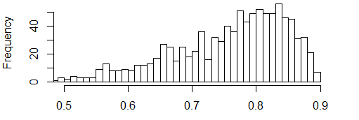
Generation of Adjusted CIs
Average, bootstrap corrected AUC estimate
AUC
95% confidence intervals

Slide 47
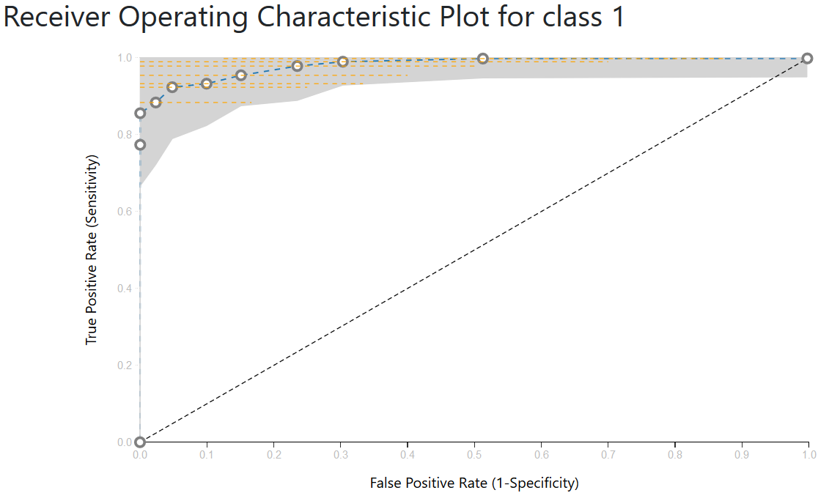
Adjusted ROC Curves with CIs

Slide 48
Bootstrap Bias Correction CV
No need for a separate Estimate hold-out set!
  Train-Tune-Estimate becomes Train-Tune
  Nested Cross Validation becomes Cross-Validation
No retraining of models
Paper shows evidence that repeating CV with different partitions to folds improves configuration selection and reduces CIs
Doesn’t work with dynamic strategies for hyper-parameter optimization

Slide 49
Messages
AI technologies represent the analyst’s knowledge
Optimization methods tune the hyper-parameters
Estimation of performance is challenging and requires special protocols, BBC-CV is the latest one
One estimates performance of a complete configuration, not each step individually

Slide 50
Feature Selection for Knowledge Discovery

Slide 51
Roadmap: Increased knowledge and intuition
Predict the future based on the past: Predictive analytics
Find what predicts the future: Feature Selection
Find out how to control the future: Causal Discovery

Slide 52
Knowledge Discovery and Feature Selection
Feature Selection = Knowledge Discovery
  The primary task in many applications
  Seems to be related to the causal mechanisms of the phenotype
      Features not selected must be either (causally) irrelevant or only indirectly (causally) related
  Resulting models easier to visualize, verify, understand
  Dimensionality Reduction (e.g., PCA) is harder to interpret

Slide 53
Feature Selection Problem(s)
Single Feature Selection: Find one minimal set of features that collectively carry all the information for optimal prediction
  Minimal: Throw away irrelevant or superfluous features
  Collectively: May need to consider interactions
  Optimal: Requires constructing a classification / regression model and estimating its performance
Multiple Feature Selection: Find all such sets
 |  | Expression Values
 |  | Genes / Probe Sets |  |  |  |  |  |  | Metastatic?
 |  | AFFX-BloB-5_at | AFFX-BloB-M_at | AFFX-Blob-3_at | AFFX-BloC-5_at | … | Affx-Bloc-3_at | AFFX-BloDn-5_at
Sample | 1 | 123.00 | 1.00 | 2,3 | 12.00 |  | 23.00 | 34.00 | Yes
 | 2 | 323.00 | 23.00 | 4,54 | 2.00 |  | 21.00 | 65.00 | No
 |  |  |  |  |  |  |  |  | No
 |  |  |  |  |  |  |  |  | No
 | N | 232.00 | 4,5 | 23.00 | 0,55 |  | 75.00 | 343.00 | Yes
{AFFX-BloB-5_at, AFFX-Blob-3_at}
{AFFX-BloC-5_at, Affx-Bloc-3_at}

Slide 54
A Taxonomy of Feature Types
X provides no information for T in all contexts: X is irrelevant
X in all solutions (Markov Blankets): X indispensable
X not indispensable, but X in some solutions: X replaceable
  Replaceable features will not be stably selected!
X not irrelevant, or indispensable, or replaceable: X is redundant
  X provides information for predicting T in some context, but not required
Older classification to irrelevant, weakly relevant, strongly relevant (Kohavi & John, 1997) coincides with irrelevant, redundant, indispensable when solution is unique

Slide 55
Multiple Feature Selection
Say X is replaceable with Y:
  Informationally equivalent with respect to the outcome T
  Does not mean they are highly correlated
They will appear as unstably selected during cross-validation
Can’t throw away unstable features!
Variance importance-weight in Random Forests, Lasso coefficients, Least-Regression coefficients, etc. distributes among replaceable features
Need algorithms specifically for multiple feature selection returning all solutions

Slide 56
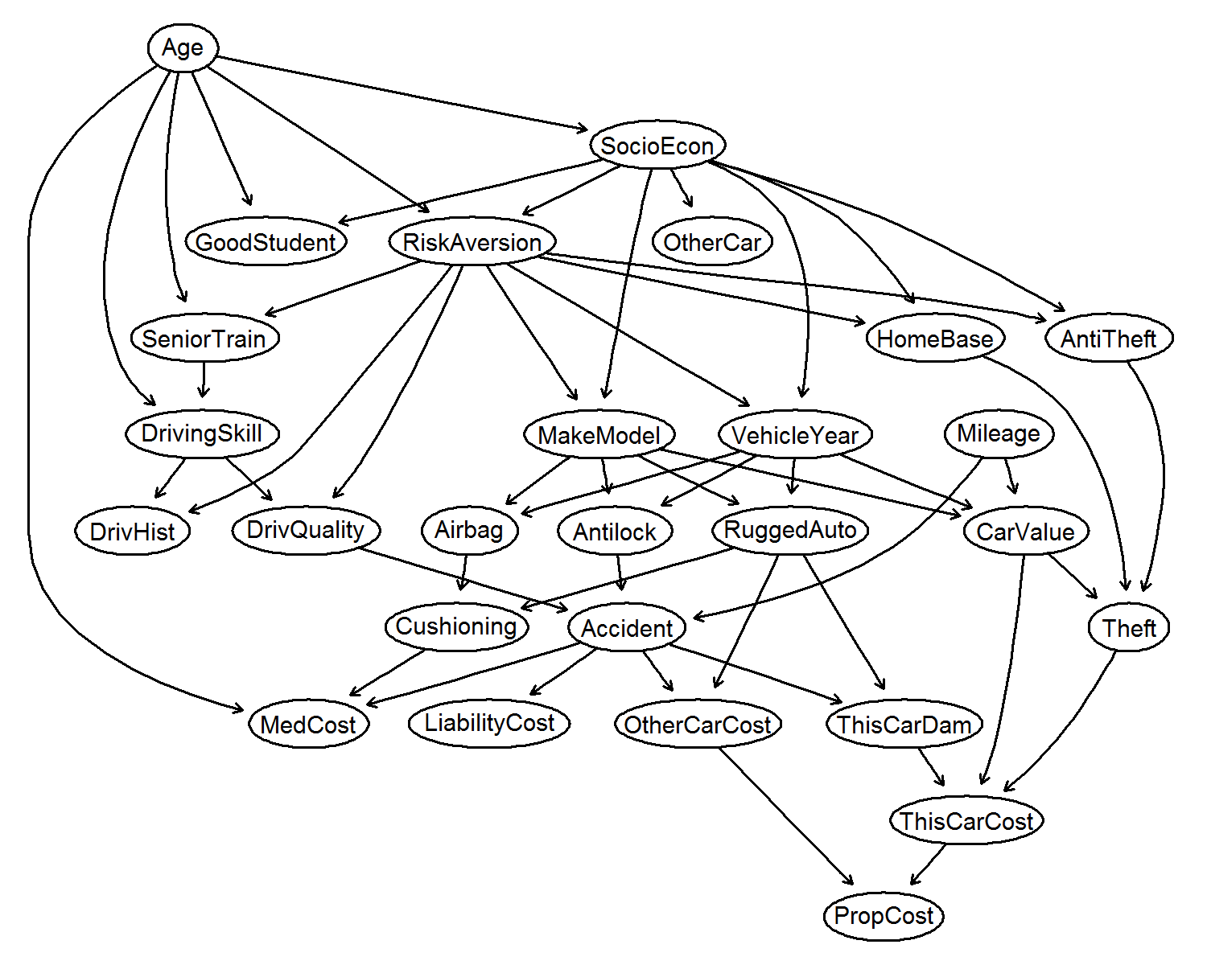
What is the Markov Blanket of MakeModel?
Markov Blanket = solution to the FS problem
  Neighbors (parents and children) of T
  Spouses of T
Theorem: The Markov Blanket of T is unique in Faithful distributions
In distributions faithful to a Bayesian Network
  Markov Blanket = indispensable
  Non-Markov Blanket features connected with a path to T are redundant
  Features not connected with a path to T are irrelevant
  There are no replaceable features
:Target
:Neighbors
:Spouses

Slide 57
Feature Selection Intrinsically Related to Causality!
Causalities determine the solution to the feature selection problem
Explains theoretically why Feature Selection is used for Knowledge Discovery
Feature selection becomes a causal discovery problem
Several Markov-blanket based algorithms available

Slide 58
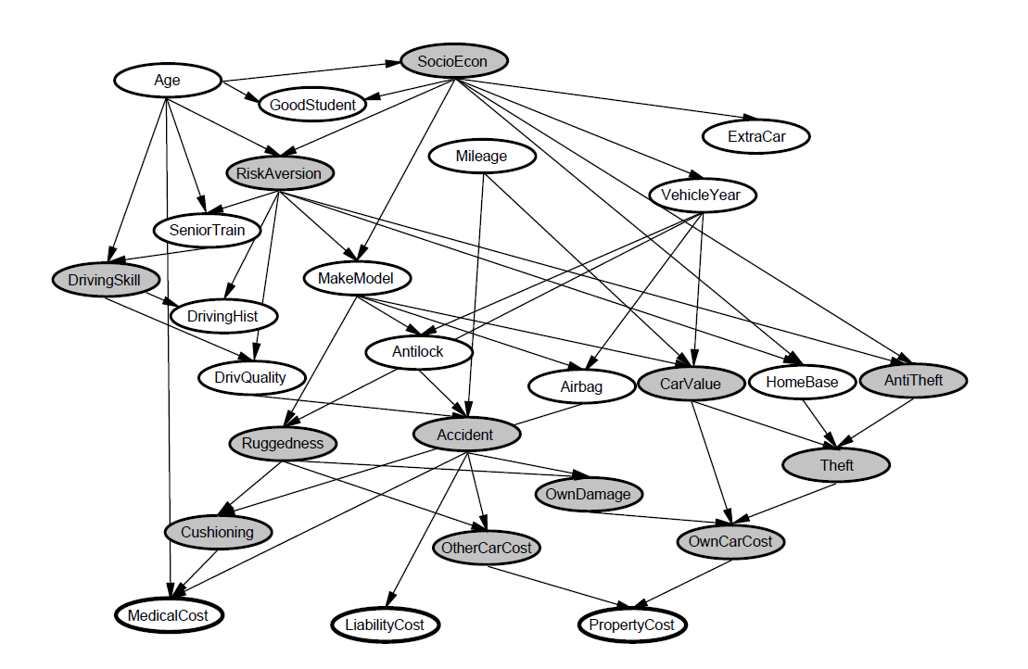
From Predictive Analytics to Prescriptive and Causal Analytics
Note: reverse-engineering problem!
(Unknown) Data-generating causal mechanism
Available Data
Reconstruction

Slide 59
Advances in Feature Selection
Scale up to tens of millions of features and/or hundreds of millions of samples (Big Data)
Scale down to very few samples (20-30)
Consider any type of outcome of interest
    Nominal, ordinal, count, time-to-event, continuous, zero-inflated continuous, time-course repeated measurement
Identify multiple, statistically equivalent solutions
Open Source R MXM Package

Slide 60
Feature Selection Methods
Algorithm | Outcome | #Samples | #Features | #solutions | Reference | Comments | Guarantees
MMPC | Any | <10³ | 10⁵ | one | [Tsamardinos, I., et al. (2003), KDD] | Better for small sample size | ⊆MB
FBED | Any | 10³ - 10⁵ | 10⁵ | one | [Borboudakis, G., et al. (2017), https://arxiv.org/abs/1705.10770] | Better for medium sample size | MB
gOMP | Any | 10³ - 10⁵ | 10⁵ | one | [Tsagris, M., et al. (2018), https://www.biorxiv.org/content/early/2018/10/03/431734] | Better for medium sample size | ⊇MB
PFBP | Any | Infinite | 10⁷ | one | [Tsamardinos, I., et al. (2017), https://arxiv.org/abs/1708.07178] | Big Data | MB
SES | Any | <10³ | 10⁵ | many | [Lagani, V., et al. (2017), 80, 7, Journal of statistical software] | Better for small sample size | ⊆MB
MLasso | Discrete, Continuous | 10⁴ | 10⁵ | many | [Pantazis, Y., et al. (2017), https://arxiv.org/abs/1710.04995] | Good overall
MgOMP | Any | 10³ - 10⁵ | 10⁵ | many |  | Upcoming | ⊇MB
Some are available as open-source R package called MXM

Slide 61
Cross-validating Feature Selection
A configuration contains feature selection
Feature selection is cross-validated
Why?

Slide 62
Overfitting by not CV-ing FS
Consider a scenario with N = 50 samples in two equal-sized classes, and p = 5000 quantitative predictors (standard Gaussian) that are independent of the class labels. The true (test) error rate of any classifier is 50%.
Wrong way
Right way
Select top correlated 100 features
For all cross-validation folds
  Run 1-nearest neighbor classifier
Return average CV error
Result: 3% error!!!
For all cross-validation folds
  Select top correlated 100 predictors
  Run 1-nearest neighbor classifier
Return average CV error
Result: 50% error
Hastie, Tibshirani, Friedman, Elements of Statistical Learning, p. 245, second edition

Slide 63
Feature Selection for Knowledge Discovery
Need to consider multiplicity of solutions
Need to cross-validate the feature selection step
Feature selection has a causal interpretation
Algorithms exist that guarantee the Markov Blanket asymptotically

Slide 64
Just Add Data Bio
Putting everything together

Slide 65
Just Add Data Bio
Automatic identification of molecular signatures
  A signature is a minimal-size set of molecular quantities that is optimally predictive for an outcome of interest
General, handling various data outcomes
  Including binary, multi-class, continuous, and time-to-event outcomes
Computationally efficient, fine-tuned implementation
  Easily handles tens of thousands of molecular quantities
High quality results, using state-of-the art techniques implementation
  Ensures methodological correctness, unbiased performance estimation
Interpretable output, helping the user understand the results
Can be used by non-expert analysts, customizable by experts
Soon available as a cloud service

Slide 66
Just Add Data Architecture
Selections are based on an AI-expert system and meta-level learning
Input
Data
ID | x₁ | x₂ | x₃ | x₄ | …. | x_{m} | target
1 | 26 | 0 | 0.3 | 0.06 | … | 2 | yes
2 | 52 | 1 | 2.3 | 0.1 | … | 2 | no
… | … | … | … | … | … | …
n | 34 | 0 | 5.8 | 0.04 | … | 3 | no
Algorithm Selection
Estimation and Tuning Protocol Selection
Configuration Generator
instances
User Preferences
Statically (dynamically in the future) decides which hp values to try

Slide 67
Just Add Data Architecture
Configurations
Estimation Protocol
Pre.
Trans.
Imp.
FS
Model.
Out-of-sample predictions for a₁
hps a₁
…
Estimation Protocol
Pre.
Trans.
Imp.
FS
Model.
Out-of-sample predictions for a_{n}
hps a_{n}

Slide 68
Just Add Data Architecture
Out-of-sample predictions for a₁
Select optimal configuration a*
Run configuration a* on all input data
Final Model
Out-of-sample predictions for a_{n}
Bootstrap Bias Correction
Performance Estimate

Slide 69
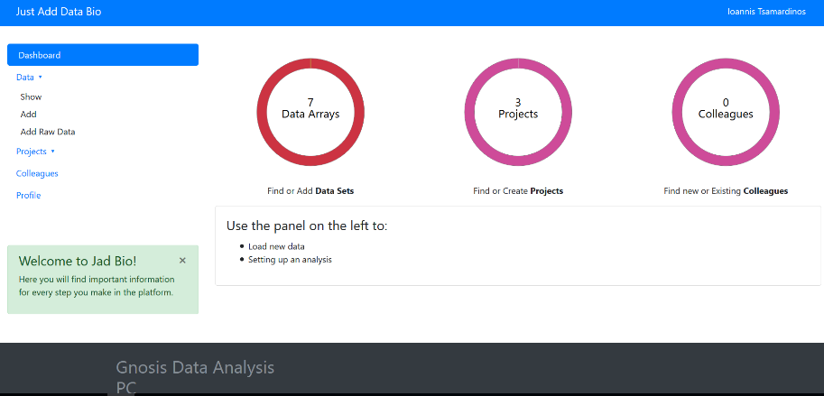
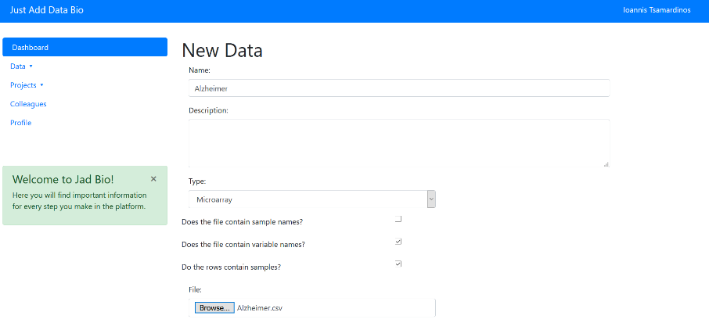
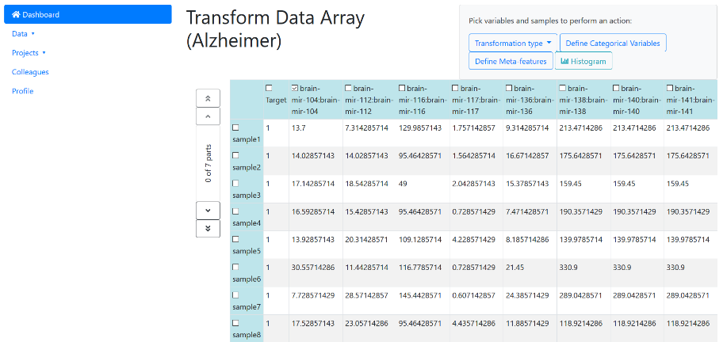
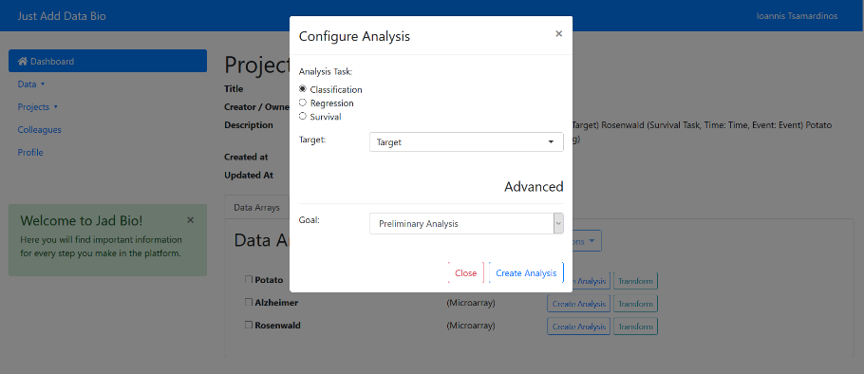
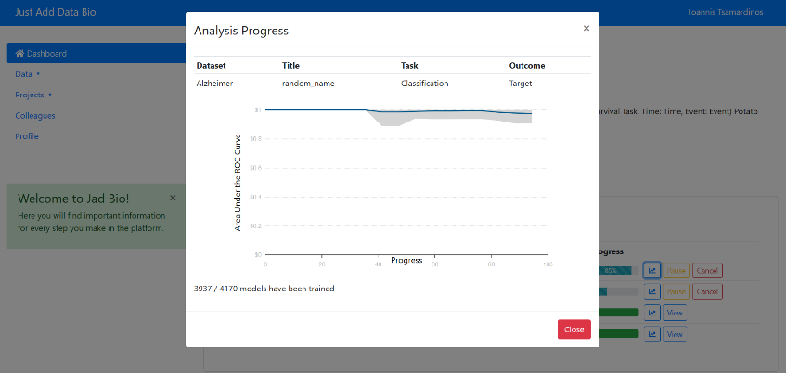
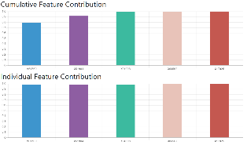
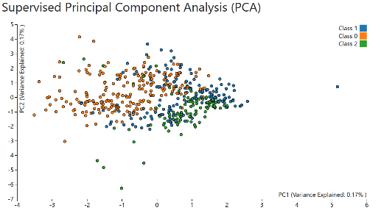
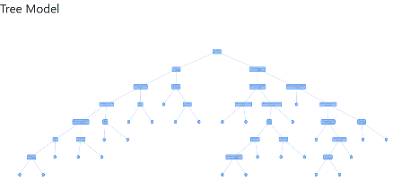
Just Add Data Bio: designed for non-experts, customizable by experts
Step 1: Select input data
Step 2: Specify data information
Step 3: Transform your data
Step 4: Specify analysis task
Step 5: Check learning progress
Step 5: Get results

Slide 70

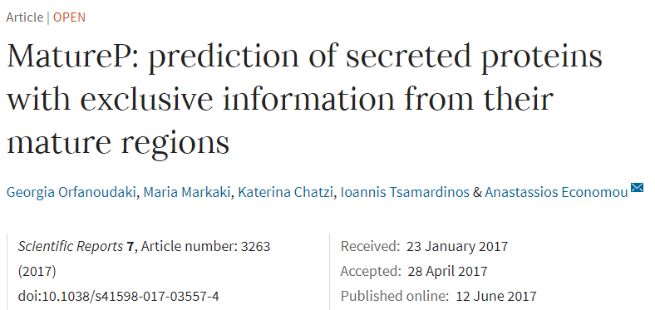

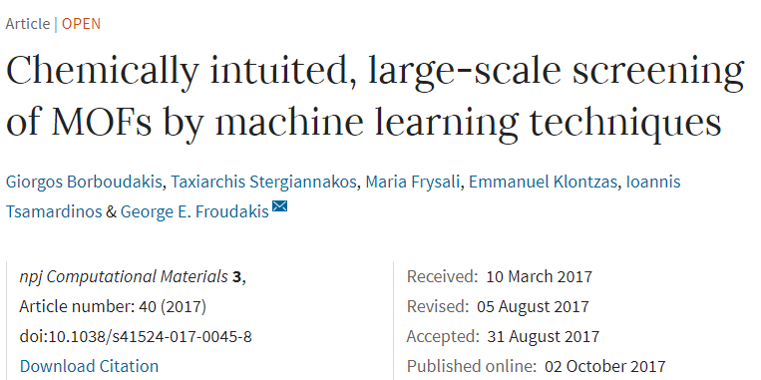
Just Add Data Bio: Applications
Prediction of protein function based on amino acid sequences
Prediction of chemical properties of nanomaterials
Prediction of suicides based on psychiatric referrals
Diagnosis of voice pathology based on speech analysis
Early diagnosis of lung cancer based on molecular profiling of blood serum (upcoming)

Slide 71

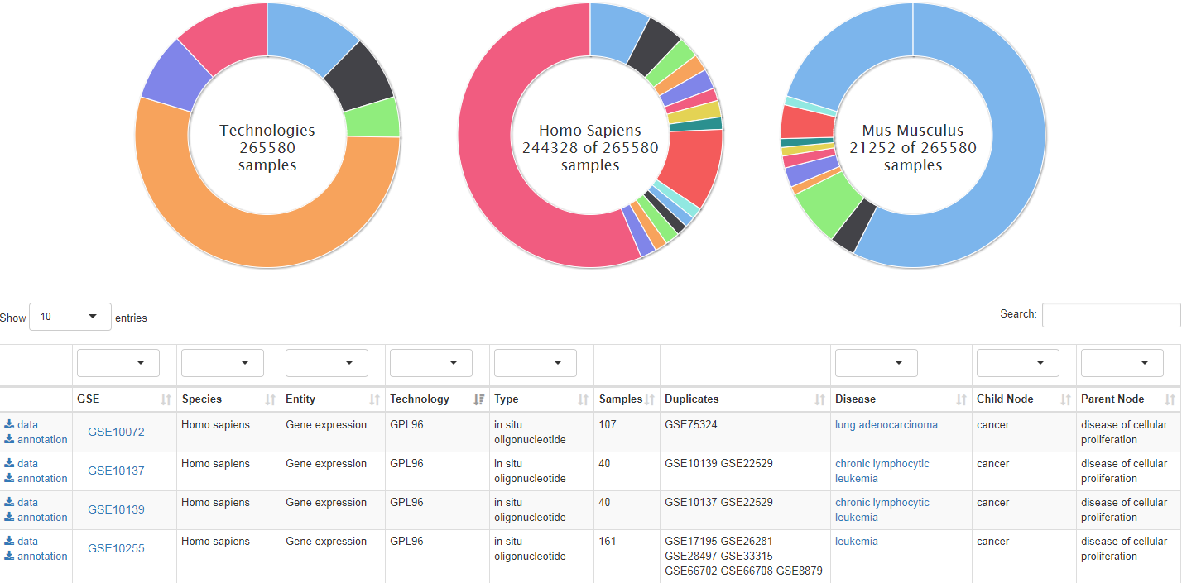
a collection of uniformly preprocessed and automatically annotated datasets for data-driven biology
http://dataome.mensxmachina.org/
Sample sharing
K. Lakiotaki, N. Vorniotakis, M. Tsagris, G. Georgakopoulos, and I. Tsamardinos, BioDataome: a collection of uniformly preprocessed and automatically annotated datasets for data-driven biology, DATABASE, 2018

Slide 72
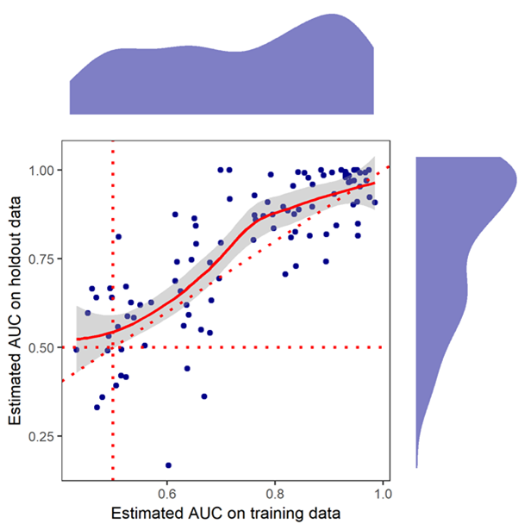
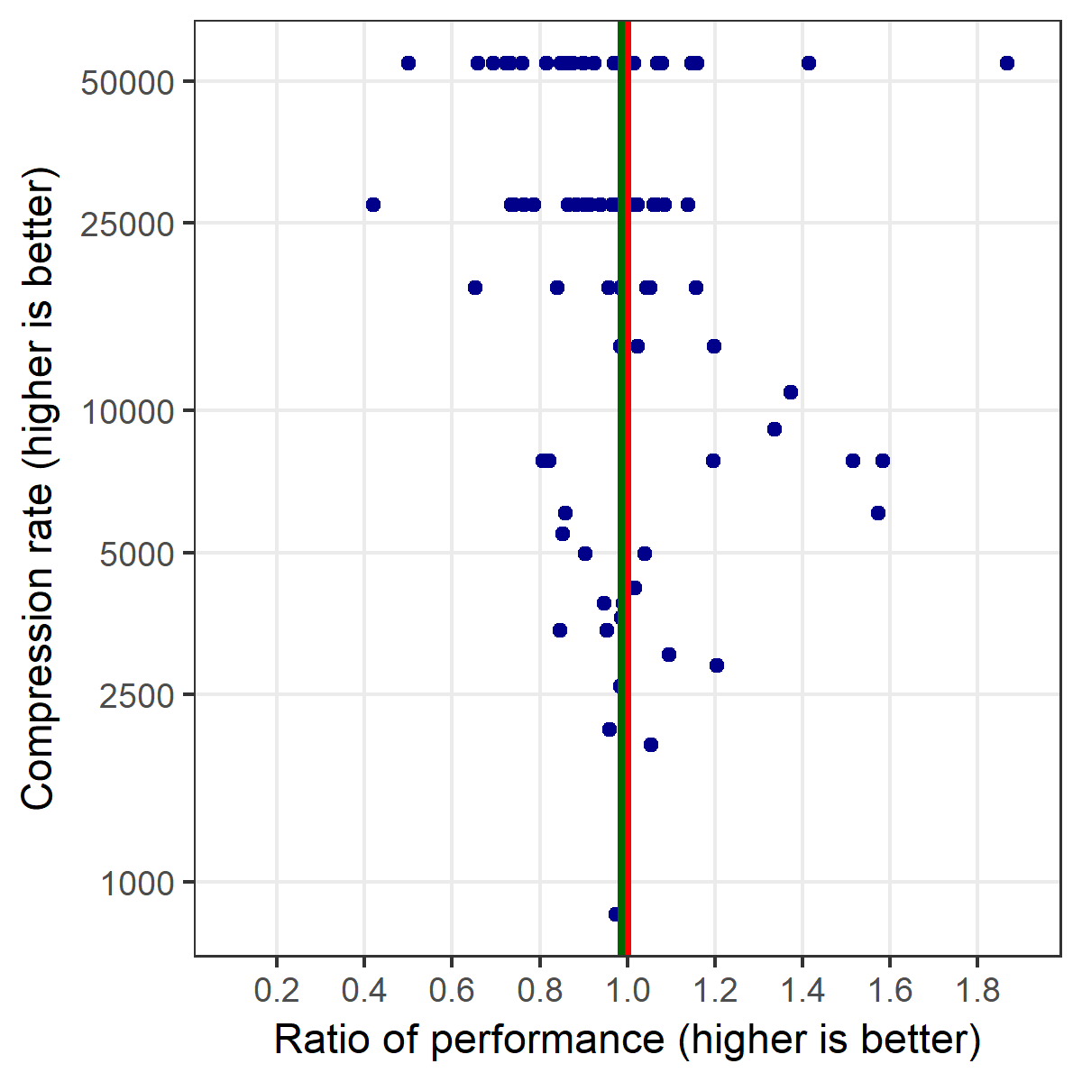
Just Add Data Bio: Massive evaluation
Conservative performance estimation
High compression rate (#total features/#selected features)
JAD Bio: ~350 datasets (~40000 samples) in ARIS-GRNET High Performance Computing Services, ~1 day)

Slide 73
Summary and Conclusions
Possible to automate large parts of predictive analytics and increase productivity
Avoids pitfalls and common errors: correct results
Incorporates best-practices and state-of-the-art, increases learning quality
Current results with Just Add Data are promising; current version handles ~7000 scenarios

Slide 74
Learn to Diagnose Alzheimers from molecular blood measurements
Given past data:
  Measurements on 70 subjects patients and controls
  503 miRNA expression levels (features)
  Whether they had Alzheimers or not (outcome / labels)
Learn to diagnose the disease on new subjects given the same measurements (predictive and diagnostic modeling)
Identify the molecular quantities that are diagnostic (feature selection)

Slide 75
Demo

Slide 76
JAD use case
Data from public GEO Database:
GDS4848-Chloroprene effect on rat lung
Sample ID | Probe set 1 | Probe set 2 | … | Probe set 31099 | Chloroprene exposure
GSM1001854 | 11.5774 | 12.4627 | … | 12.2044 | yes
GSM1001855 | 9.18588 | 9.60235 | … | 8.9753 | yes
… | … | … | … | … | …
GSM1001819 | 8.53815 | 8.41135 | … | 6.78468 | no
Classification problem
Can we predict chloroprene exposure from gene expression data?
50 lung tissue rat samples, 40 exposed to chloroprene and 10 controls

Slide 77
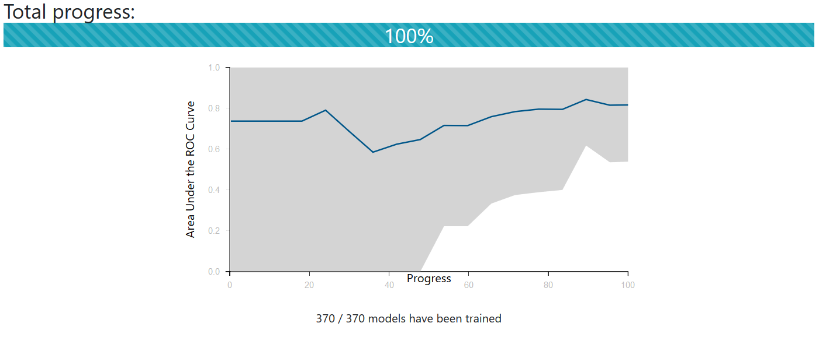
JAD - learning progress

Slide 78
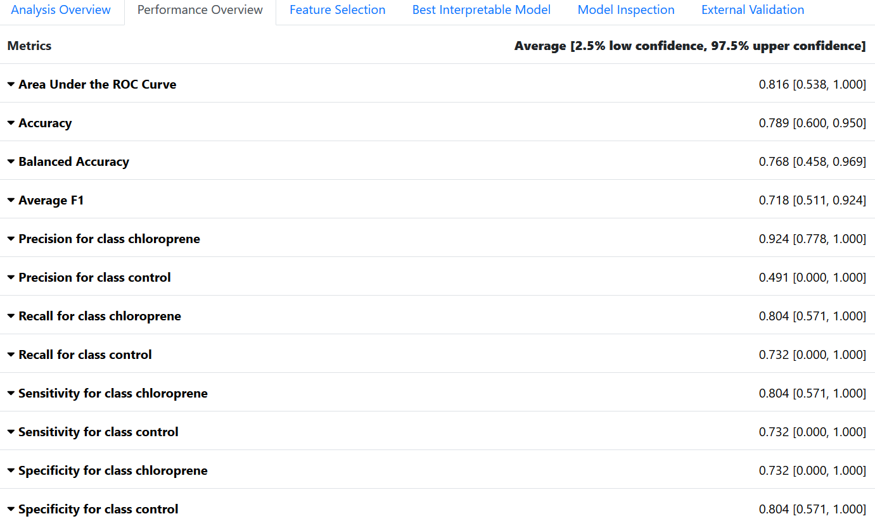
JAD - Performance overview

Slide 79
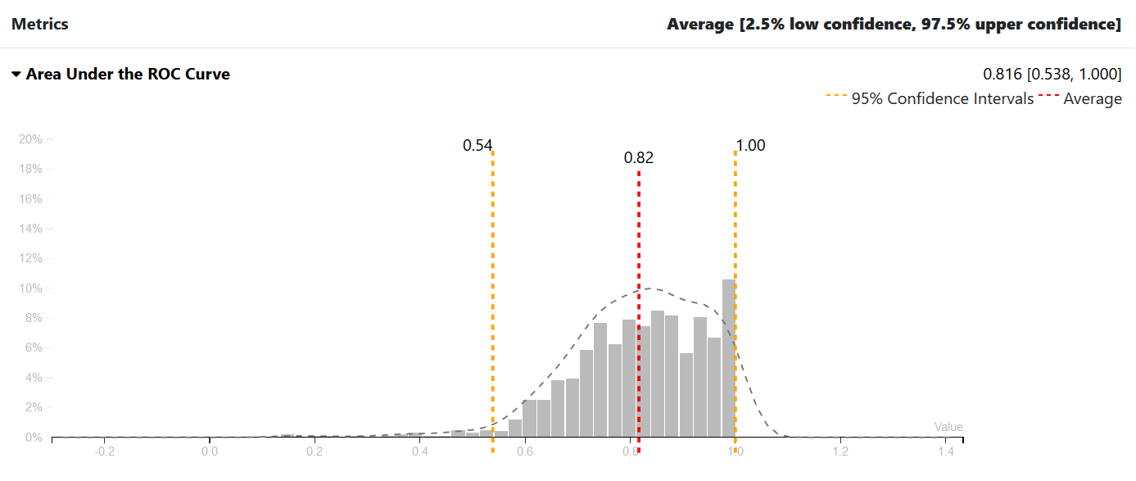
JAD Results-AUC

Slide 80
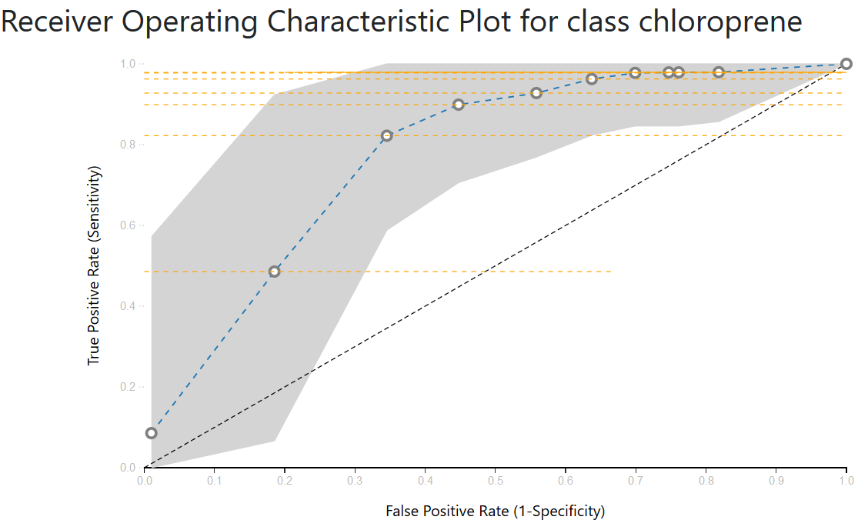
JAD Results-ROC

Slide 81
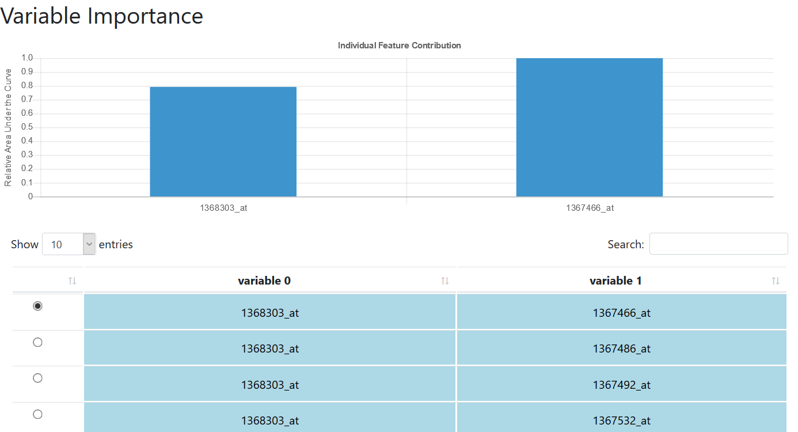
JAD Results-Variable importance
2 variables selected, 25 signatures

Slide 82
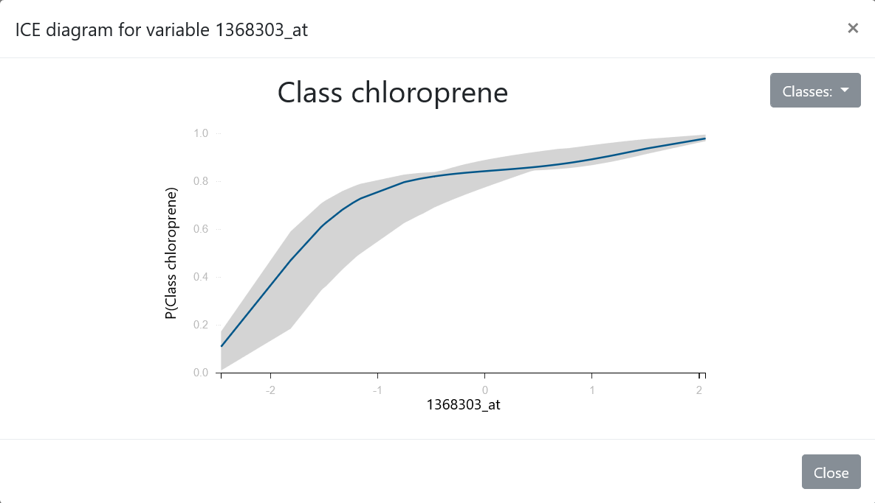
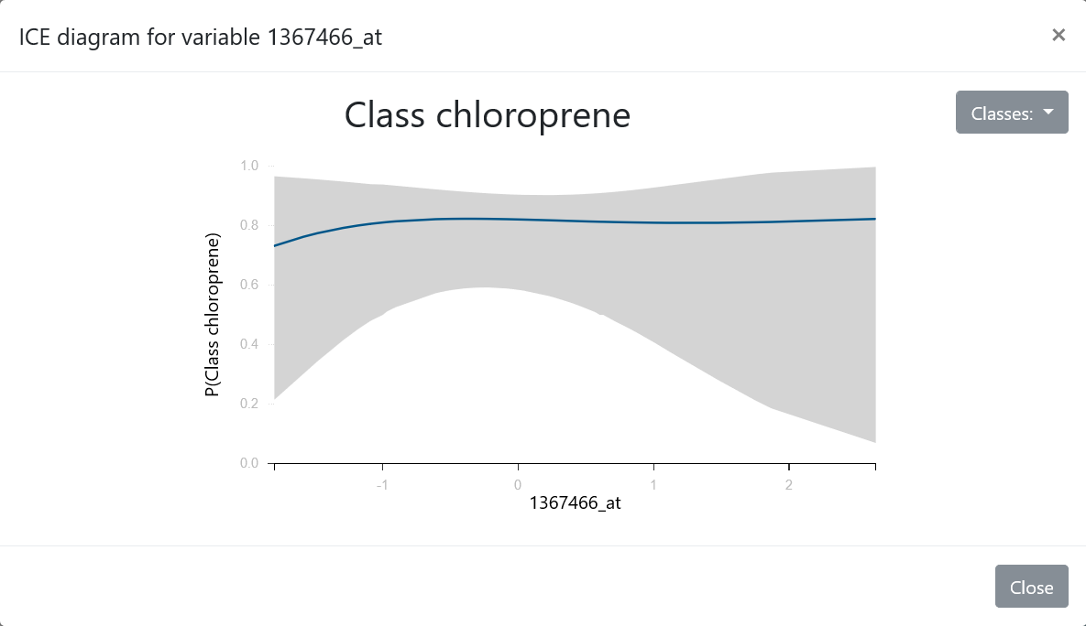
ICE diagram: visualizing effect sizes in general models

Slide 83
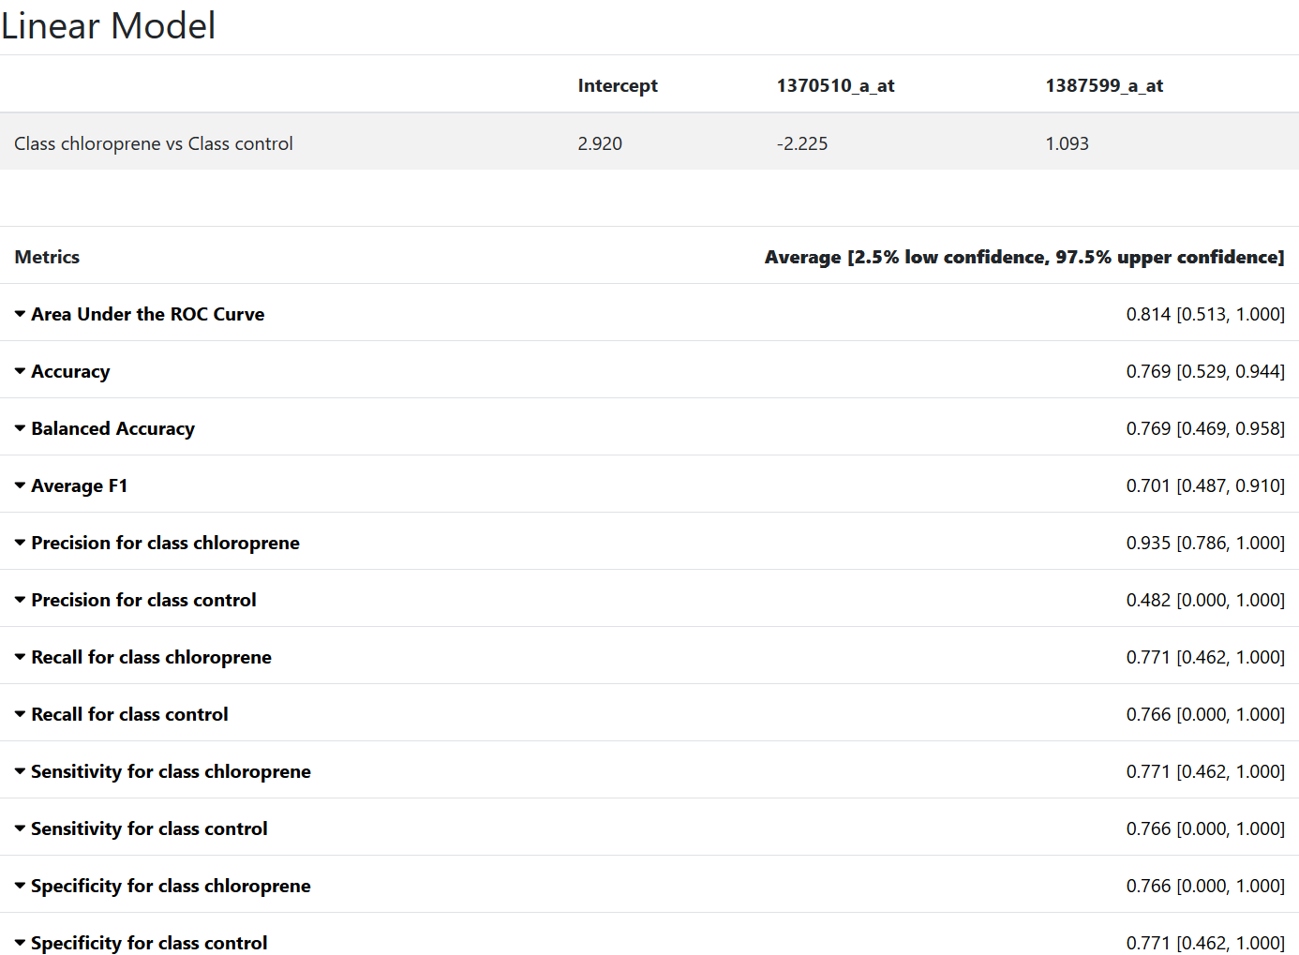
JAD Results-best interpretable model

Slide 84
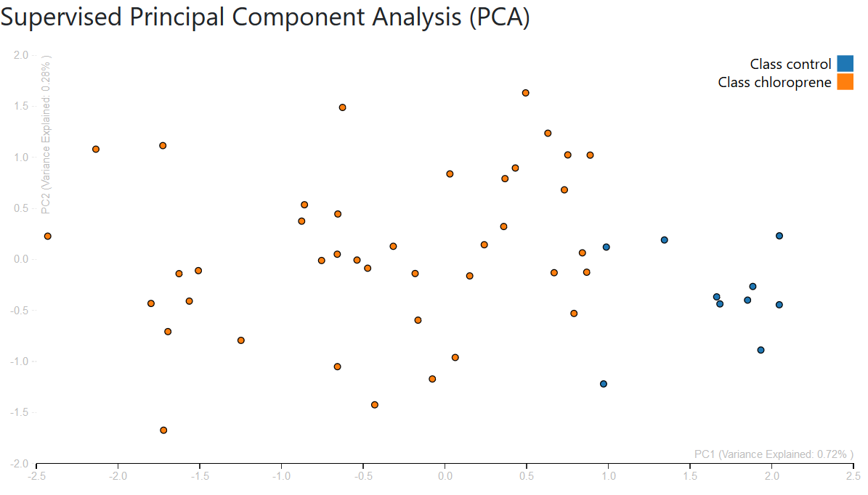
JAD Results-supervised PCA

Slide 85


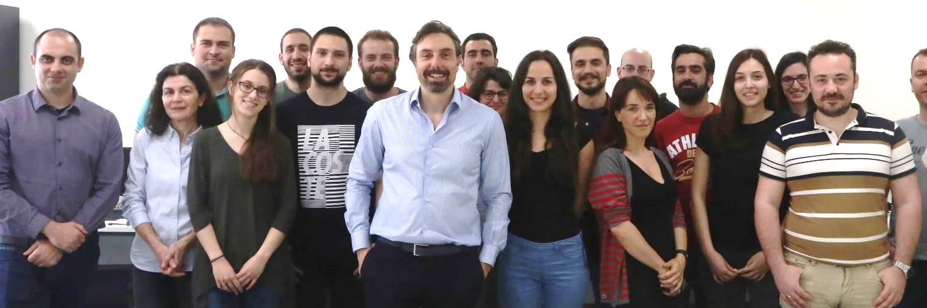
Acknowledgements
Mens Ex Machina Group
Gnosis Data Analysis IKE
Funding and Hosting:
  ERC CAUSALPATH project, EU STATegra project
  University of Crete
  Greek Research and Technology Network (GRNET) in the National HPC facility—ARIS
mensxmachina.org
www.gnosisda.com
Particularly this presentation:
Vincenzo Lagani
Pavlos Charonyktakis
Klio Lakiotaki

Slide 86
References
Pance Panov , Sašo Džeroski , Larisa Soldatova, OntoDM: An Ontology of Data Mining, 2008 IEEE International Conference on Data Mining Workshops
Žáková, M., Kremen, P., Železný, F., Lavrač, N.: Automating knowledge discovery workflow composition through ontology-based planning. IEEE Transactions on Automation Science and Engineering 8(2), 253–264 (2010)
Claudia Diamantini, Domenico Potena, Emanuele Storti, Ontology-Driven KDD Process Composition, International Symposium on Intelligent Data Analysis, IDA 2009
Kietz, J.; Serban, F.; Bernstein, A.; Fischer, S. Towards cooperative planning of data mining workflows. In: Podpeˇcan, V.; Lavraˇc, N.; Kok, J.; de Bruin, J. (eds.) Proceedings of Workshop on Third Generation Data Mining: Towards Service-Oriented Knowledge Discovery. 1–13 (2009).
Hilario, M.; Kalousis, A.; Nguyen, P.; Woznica, A. A data mining ontology for algorithm selection and Meta-Mining. In: Podpeˇcan, V.; Lavraˇc, N.; Kok, J.; de Bruin, J. (eds.) Proceedings of Workshop on Third Generation Data Mining: Towards Service-Oriented Knowledge Discovery. 76–88 (2009).
Felix Mohr, Marcel Wever, and Eyke H¨ullermeier. ML-Plan: Automated machine learning via hierarchical planning. Machine Learning, Jul 2018
Feurer et al, Methods for Improving Bayesian Optimization for AutoML, JMLR C&W 2015

Slide 87
References
Olson R.S., Urbanowicz R.J., Andrews P.C., Lavender N.A., Kidd L.C., Moore J.H. (2016) Automating Biomedical Data Science Through Tree-Based Pipeline Optimization. In: Squillero G., Burelli P. (eds) Applications of Evolutionary Computation. EvoApplications 2016. Lecture Notes in Computer Science, vol 9597. Springer, Cham
Ye F (2017) Particle swarm optimization-based automatic parameter selection for deep neural networks and its applications in large-scale and high-dimensional data. PLoS ONE 12(12): e0188746.
Hutter, Frank, Holger H. Hoos, and Kevin Leyton-Brown. "Sequential model-based optimization for general algorithm configuration." International Conference on Learning and Intelligent Optimization. Springer, Berlin, Heidelberg, 2011.
Thornton, Chris, et al. "Auto-WEKA: Combined selection and hyperparameter optimization of classification algorithms." Proceedings of the 19th ACM SIGKDD international conference on Knowledge discovery and data mining. ACM, 2013.

Slide 88
References
Ι. Tsamardinos, Ε. Greasidou, G. Borboudakis, “Bootstrapping the Out-of-sample Predictions for Efficient and Accurate Cross-Validation”, Machine Learning 2018
Kohavi & John, “Wrappers for feature subset selection”Artificial Intelligence, 97, 1-2,1997.
Hastie, Tibshirani, Friedman, Elements of Statistical Learning, p. 245, second edition
Lagani, V., et al. (2017), Statistically Equivalent Signatures, 80, 7, Journal of statistical software
Pantazis, Y., et al. (2017), Multiple Equivalent Solutions for the Lasso https://arxiv.org/abs/1710.04995
Tsamardinos, I., et al. (2003), Time and sample efficient discovery of Markov blankets and direct causal relations, KDD
Borboudakis, G., et al. (2017), Forward-Backward Selection with Early Dropping, https://arxiv.org/abs/1705.10770
Tsagris, M., et al. (2018), Efficient feature selection on gene expression data: Which algorithm to use?, https://www.biorxiv.org/content/early/2018/10/03/431734
Tsamardinos, I., et al. (2017), Massively-Parallel Feature Selection for Big Data https://arxiv.org/abs/1708.07178
K. Lakiotaki, N. Vorniotakis, M. Tsagris, G. Georgakopoulos, and I. Tsamardinos, BioDataome: a collection of uniformly preprocessed and automatically annotated datasets for data-driven biology, DATABASE, 2018

